Slide 1




Data types with

Slide 2
Navigate to the 03-Types folder.
Open 03-Types-Exercises.Rmd

Slide 3
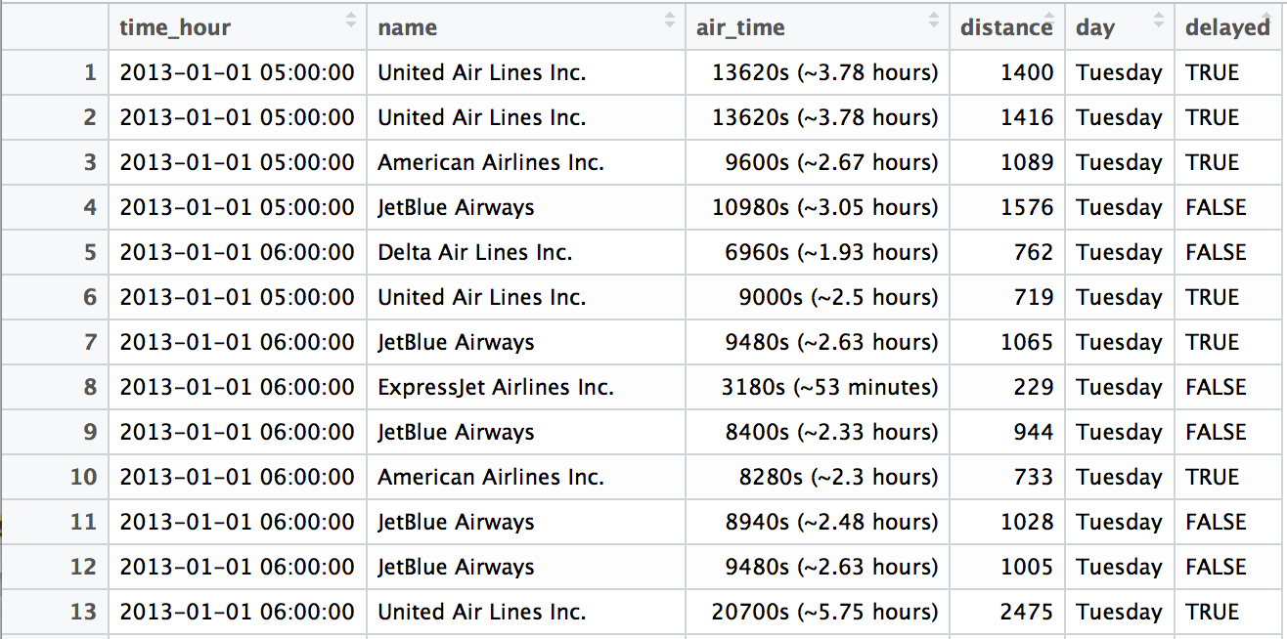
Recall
What types of data are in this data set?

Slide 4

Common data types
Logicals
Strings
Factors
Dates and Times

Slide 5
Logicals

Slide 6
Logicals
R's data type for boolean values (i.e. TRUE and FALSE).
TRUE
## TRUE
typeof(TRUE)
## "logical"
typeof(c(TRUE, TRUE, FALSE))
## "logical"

Slide 7

nycflights13
Data about every flight that departed La Guardia, JFK, or Newark airports in 2013
❒
# install.packages("nycflights13")
library(nycflights13)

Slide 8
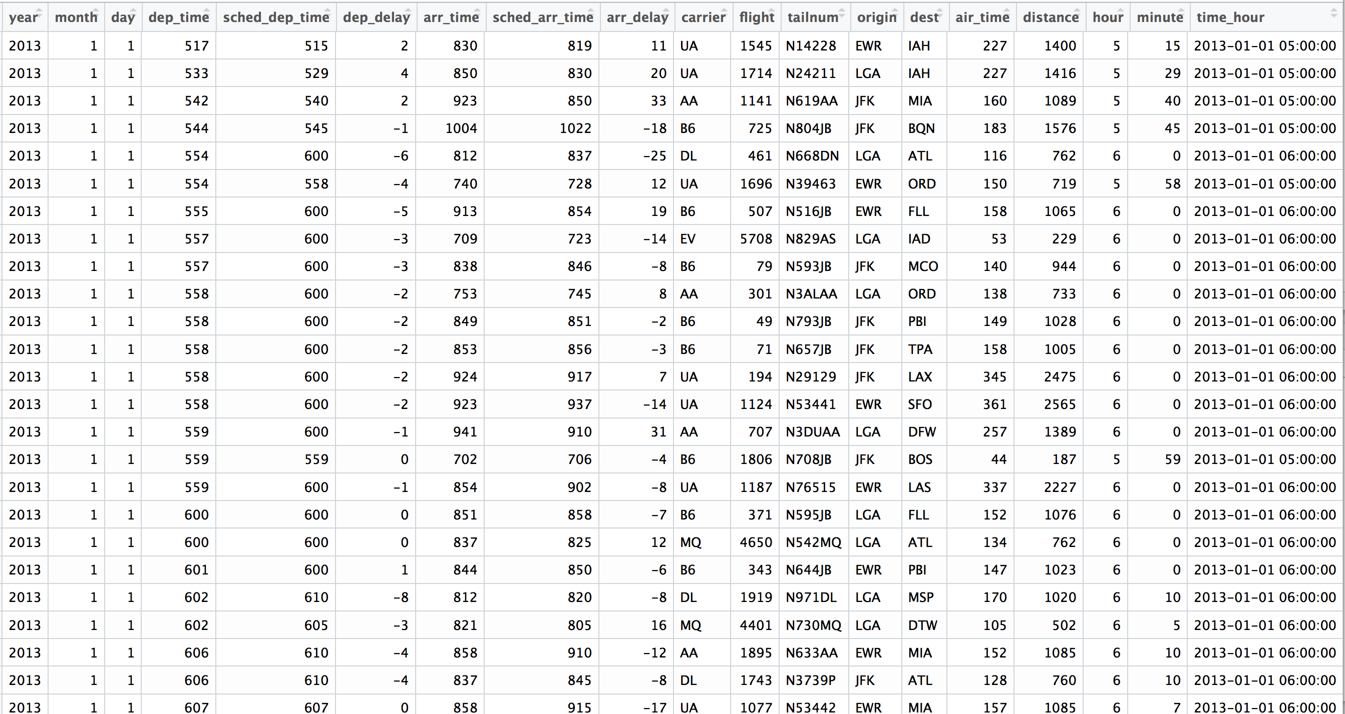
Flights
View(flights)

Slide 9
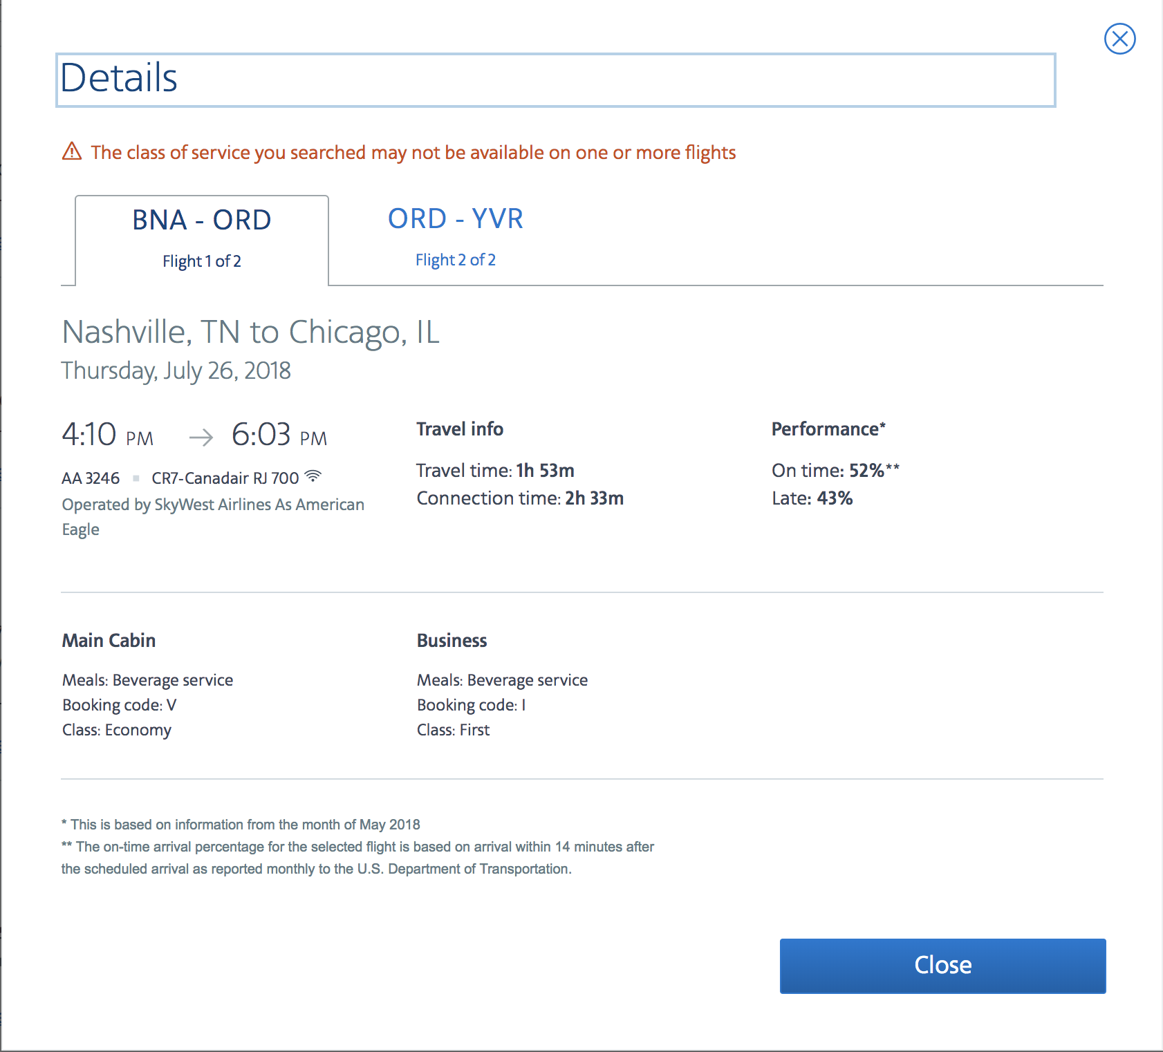

Slide 11
Warm Up
Did you fly here?
Did your flight arrive late?

Slide 12
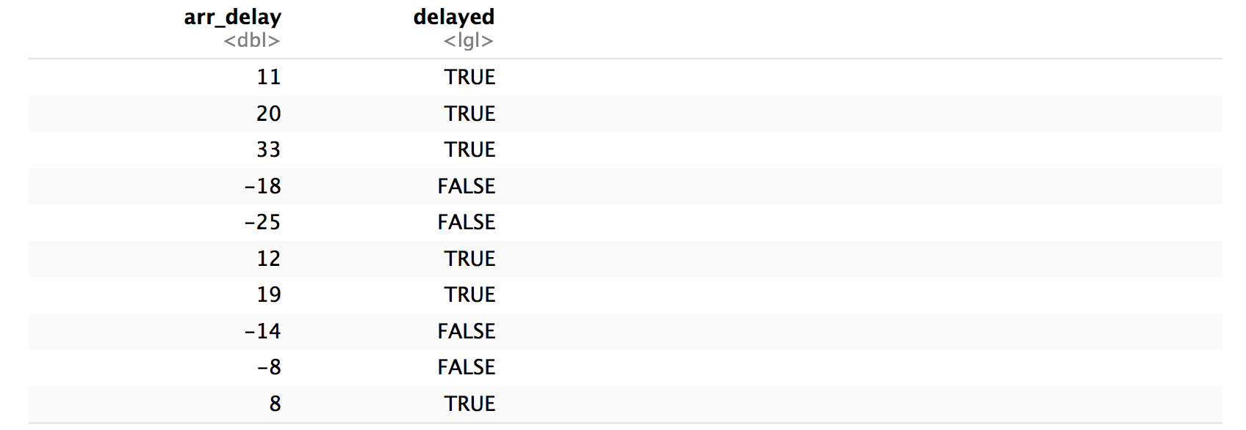
flights %>%
mutate(delayed = arr_delay > 0) %>%
select(arr_delay, delayed)

Slide 13
flights %>%
mutate(delayed = arr_delay > 0) %>%
select(arr_delay, delayed)
Can we compute the proportion of NYC flights that arrived late?

Slide 14
Most useful skills
Logical tests
Math with logicals

Slide 15
Quiz
What does this return?
TRUE + 0
Not an Error!

Slide 16
Quiz
What does this return?
TRUE + 0
1

Slide 17
Math with logicals
TRUE = 1
FALSE = 0

Slide 18
Quiz
What will this return?
sum(c(FALSE, FALSE, TRUE, FALSE))
The Number of TRUEs

Slide 19
Quiz
What will this tell us?
sum(flights$arr_delay > 0)
The Number of DELAYED FLIGHTS

Slide 20
Quiz
What will this tell us?
mean(flights$arr_delay > 0)
The proportion of DELAYED FLIGHTS

Slide 21
TRUE = 1
FALSE = 0
sum() = number that pass
mean() = proportion that pass

Slide 22
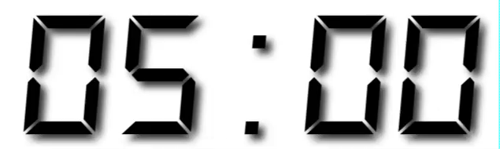
Your Turn 1
Use flights to create delayed, a variable that displays whether a flight was delayed (arr_delay > 0).
Then, filter to rows where delayed does not equal NA.
Finally, create a summary table that shows:
How many flights were delayed
What proportion of flights were delayed

Slide 23
flights %>%
mutate(delayed = arr_delay > 0) %>%
filter(!is.na(delayed)) %>%
summarise(total = sum(delayed), prop = mean(delayed))
## # A tibble: 1 × 2
## total prop
## <int> <dbl>
## 1 133004 0.4063101

Slide 24
Strings

Slide 25
(character) strings
Anything surrounded by quotes(") or single quotes(').
"one"
## "one"
typeof("one")
## "character"
typeof("oops. I'm stuck in a string)
+
")
## "character"

Slide 26

Warm Up
Decide in your group:
Are boys names or girls names more likely to end in a vowel?

Slide 27
babynames
Names of male and female babies born in the US from 1880 to 2017. 1.9M rows.
R package
# install.packages("babynames")
library(babynames)

Slide 28
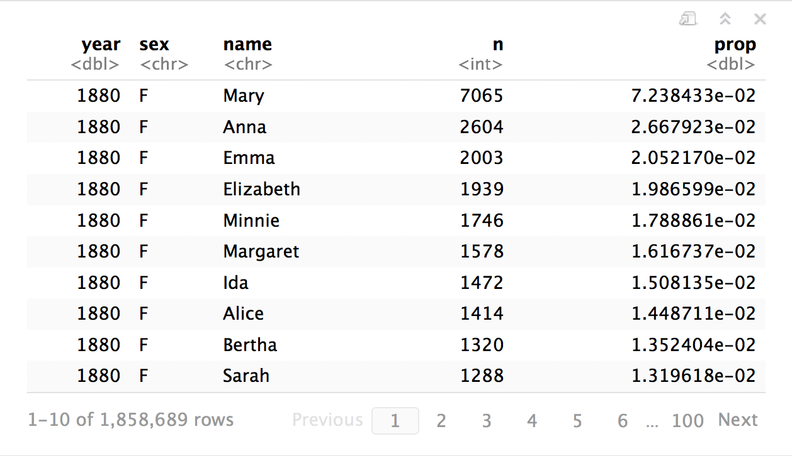
babynames
How can we build the proportion of boys and girls whose name ends in a vowel?

Slide 29
Most useful skills
How to extract/ replace substrings
How to find matches for patterns
Regular expressions

Slide 30
stringr
Simple, consistent functions for working with strings.
# install.packages("tidyverse")
library(tidyverse)

Slide 31
str_sub()
Extract or replace portions of a string with str_sub()
str_sub(string, start = 1, end = -1)
string(s) to manipulate
position of first character to extract within each string
position of last character to extract within each string

Slide 32
Quiz
What will this return?
str_sub("Garrett", 1, 2)

Slide 33
Quiz
What will this return?
str_sub("Garrett", 1, 2)
"Ga"

Slide 34
Quiz
What will this return?
str_sub("Garrett", 1, 1)

Slide 35
Quiz
What will this return?
str_sub("Garrett", 1, 1)
"G"

Slide 36
Quiz
What will this return?
str_sub("Garrett", 2)

Slide 37
Quiz
What will this return?
str_sub("Garrett", 2)
"arrett"

Slide 38
Quiz
What will this return?
str_sub("Garrett", -3)

Slide 39
Quiz
What will this return?
str_sub("Garrett", -3)
"ett"

Slide 40
Quiz
What will this return?
g <- "Garrett"
str_sub(g, -3) <- "eth"
g

Slide 41
Quiz
What will this return?
g <- "Garrett"
str_sub(g, -3) <- "eth"
g
"Garreth"

Slide 42
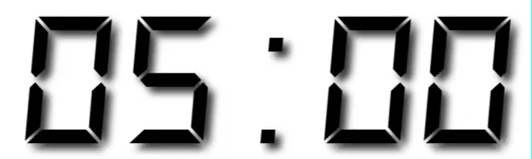
Your Turn 2
In your group, fill in the blanks to:
Isolate the last letter of every name
and create a logical variable that displays whether the last letter is one of "a", "e", "i", "o", "u", or "y".
Use a weighted mean to calculate the proportion of children whose name ends in a vowel (by year and sex)
and then display the results as a line plot.

Slide 43
babynames %>%
mutate(last = str_sub(name, -1),
vowel = last %in% c("a", "e", "i", "o", "u", "y")) %>%
group_by(year, sex) %>%
summarise(p_vowel = weighted.mean(vowel, n)) %>%
ggplot() +
geom_line(mapping = aes(year, p_vowel, color = sex))

Slide 44
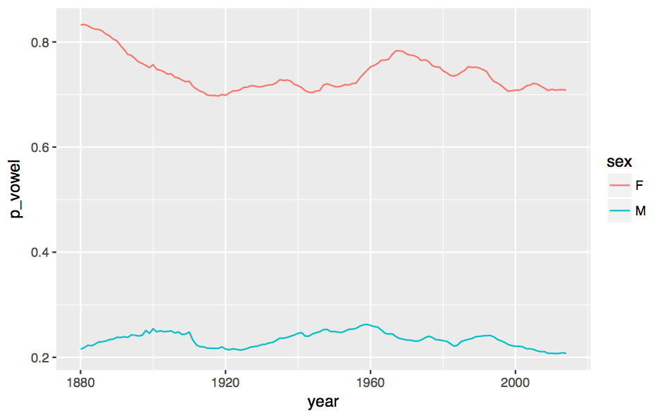
Proportion of names that end in a vowel

Slide 45
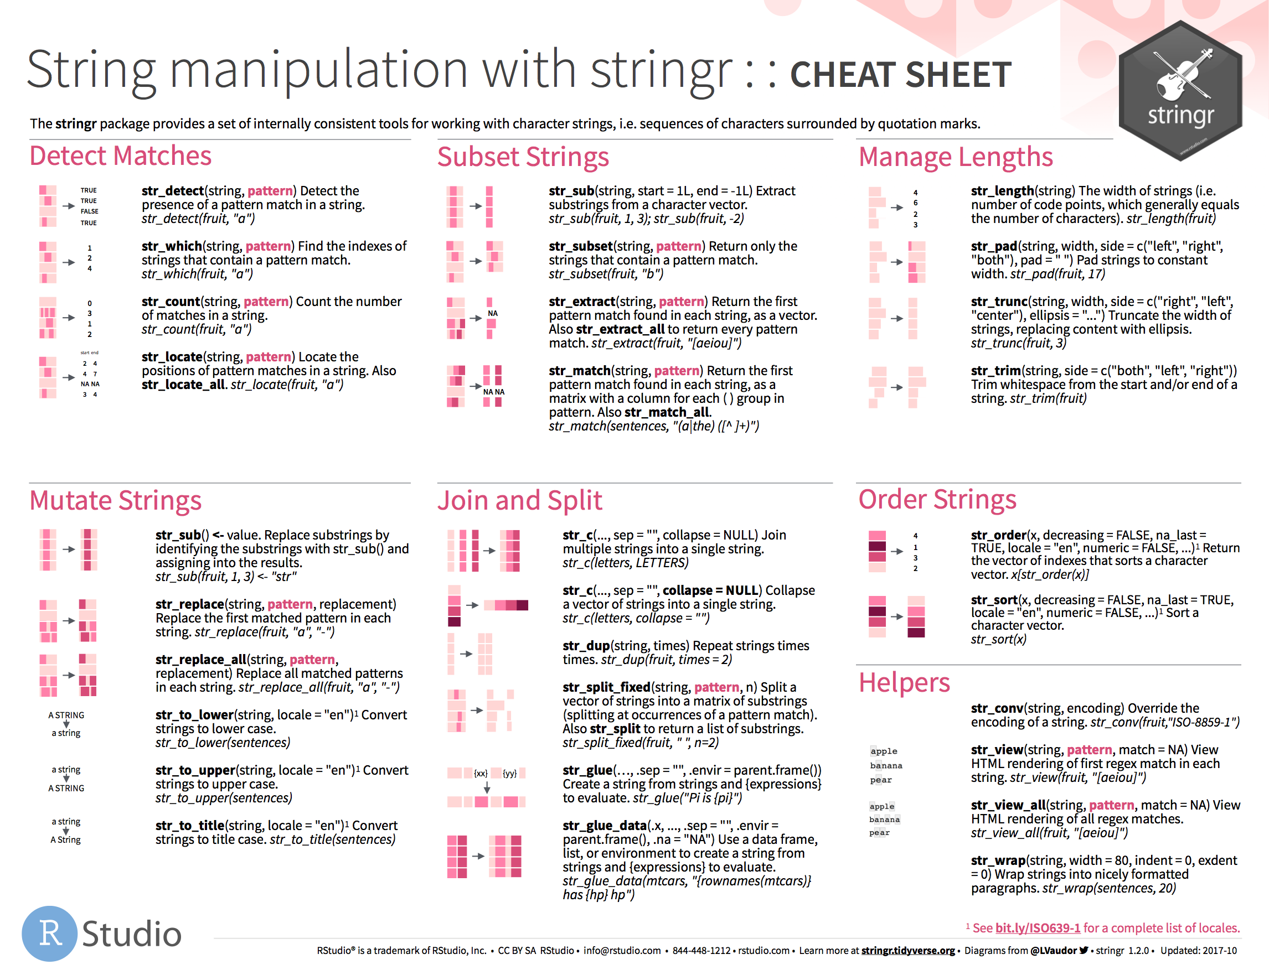
strings

Slide 46
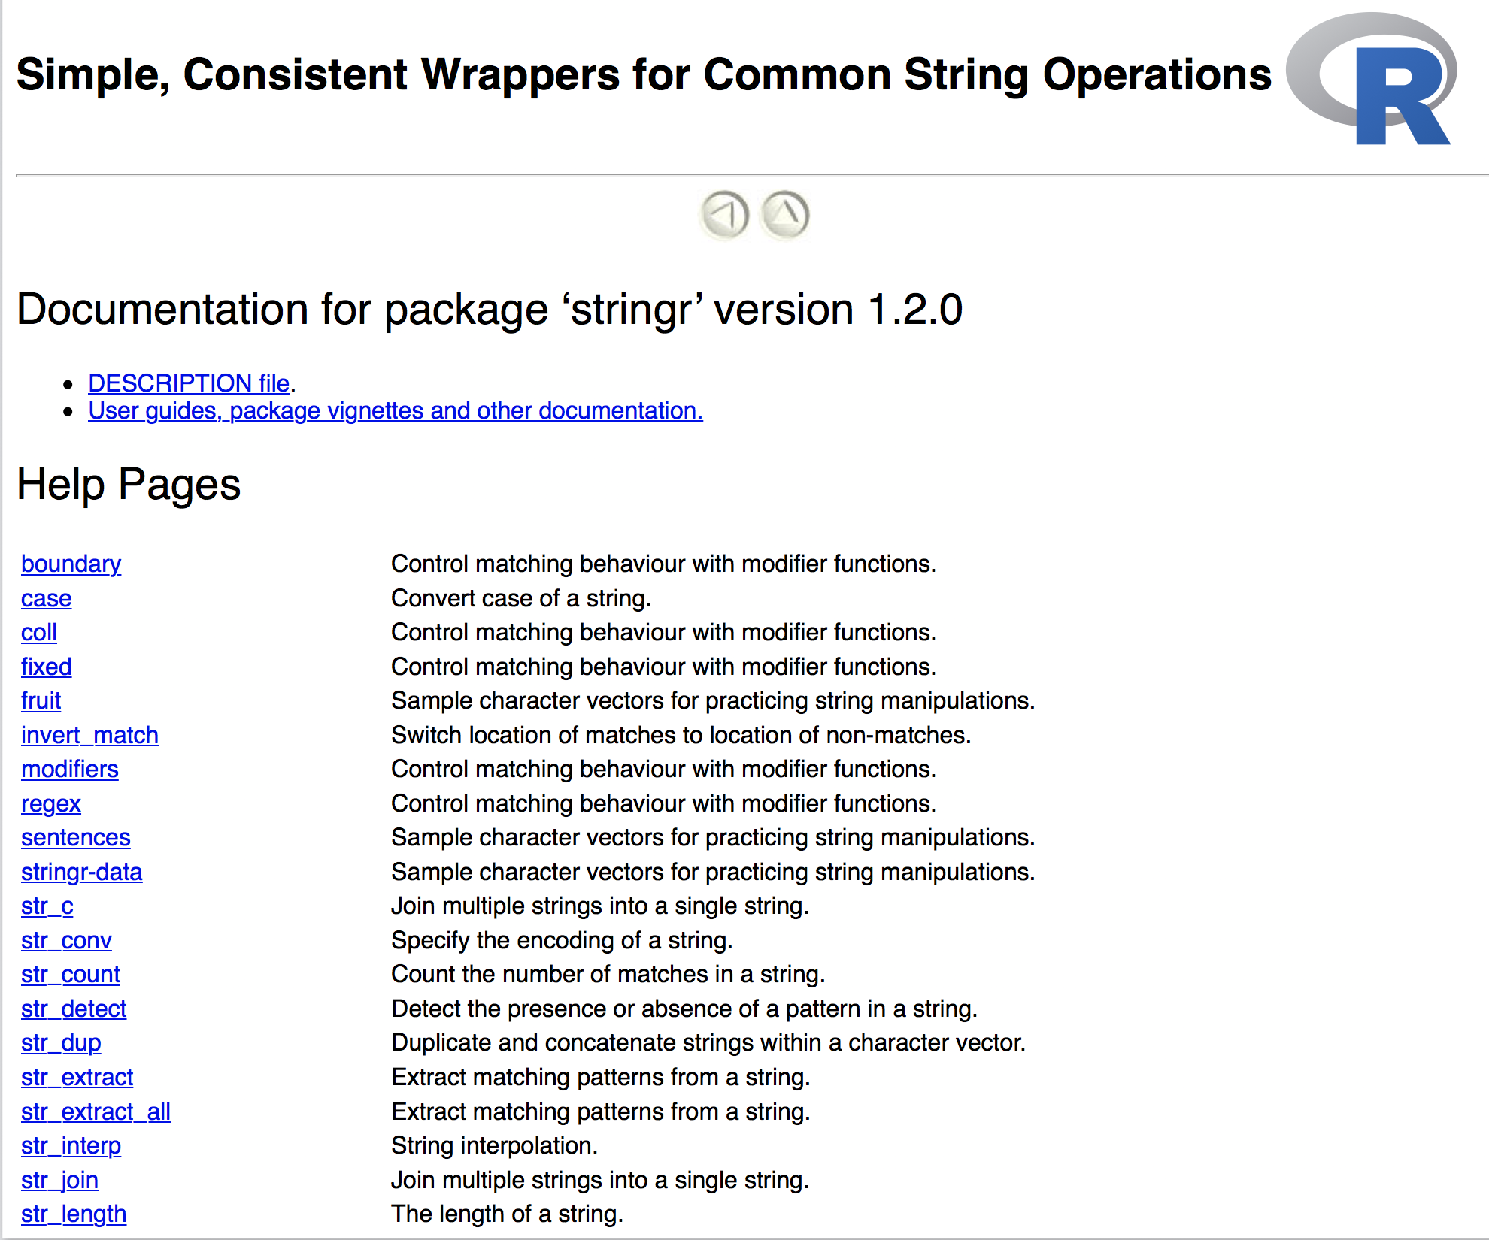
help(package = stringr)

Slide 47
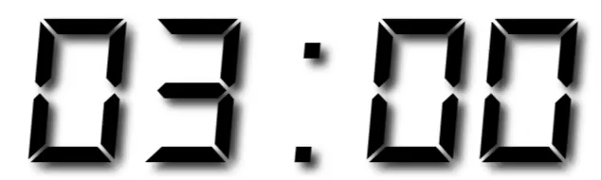
Your Turn
Run help(package = stringr) to open the help directory for stringr.
Read through the function descriptions and find the function that determines whether two strings match.
The first person in your group to find it wins!

Slide 48
str_detect()
Test whether a pattern appears within a string.
str_detect(string, pattern)
vector of strings to find patterns in
a string that represents a regular expression

Slide 49
Quiz
What will this return?
strings <- c("Apple", "Orange")
str_detect(strings, "pp")

Slide 50
Quiz
What will this return?
strings <- c("Apple", "Orange")
str_detect(strings, "pp")
TRUE FALSE

Slide 51
Quiz
What will this return?
strings <- c("Apple", "Pineapple")
str_detect(strings, "apple")

Slide 52
Quiz
What will this return?
strings <- c("Apple", "Pineapple")
str_detect(strings, "apple")
FALSE TRUE

Slide 53
Quiz
What will this return?
"AC\DC"

Slide 54
Quiz
What will this return?
"AC\DC"
Error: '\D' is an unrecognized escape in character string starting ""AC\D"

Slide 55
special characters
A backslash followed by one or more characters which stand for a special type of character.
Use writeLines() to see the characters represented by a string.
## Use an escape to include a special character
writeLines("\"")
## "
writeLines("\\")
## \
A string is not a
sequence of characters itself, but a representation of a sequence of characters

Slide 56
writeLines("AC\\DC")
## AC\DC

Slide 57
Quiz
What will this return?
str_detect("AC\\DC", "\\")

Slide 58
Quiz
What will this return?
str_detect("AC\\DC", "\\")
Error in stri_detect_regex(string, pattern, opts_regex = opts(pattern)) :
Unrecognized backslash escape sequence in pattern. (U_REGEX_BAD_ESCAPE_SEQUENCE)

Slide 59
regular expressions
regex is a "language" for describing a pattern of characters, with patterns of characters, e.g.
\w*[aeiouy]\b
writeLines("\w*[aeiouy]\b")
## ERROR" \w not a recognized special character
writeLines("\\w*[aeiouy]\\b")
## "\w*[aeiouy]\b"

Slide 60
writeLines("\\")
## \
This is not a valid regular expression
(looks like an incomplete special character)

Slide 61
We want to find this
\
…which is represented by this regex
\\
…which is represented by this string
Write your patterns at this level
"\\\\"

Slide 62
We want to find this
?
…which is represented by this regex
\
…which is represented by this string
"\\"

Slide 63
We want to find this
abc
…which is represented by this regex
abc
…which is represented by this string
"abc"

Slide 64
Your Turn
How many names end in a vowel anyways?
Winnow babynames to distinct names with:
babynames %>% distinct(name)
Use str_detect() to detect names that end in a vowel (pattern = "\\w*[aeiouy]\\b")
Calculate the number of names that end in a vowel

Slide 65
babynames %>%
distinct(name) %>%
mutate(vowel = str_detect(name, "\\w*[aeiouy]\\b")) %>%
summarise(n = n(), n_vowel = sum(vowel))
# A tibble: 1 × 2
n n_vowel
<int> <int>
1 93889 55324

Slide 66
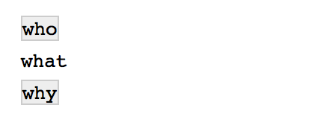
str_view()
Displays the matches of a regular expression in the Viewer pane
str_view(c("who", "what", "why"), "\\w*[aeiouy]\\b")

Slide 67
What is a date time exactly?
now <- Sys.time()
now
## "2017-01-01 00:00:01 EST"
typeof(now)
## "double"
print.default(now)
## [1] 1483246801
## attr(,"tzone")
## [1] "America/New_York"
## attr(,"class")
## [1] "POSIXct" "POSIXt"
atomic vector
(double)
augmented with attributes
(tzone, class)

Slide 68
A double that R treats in a special way
print
## function (x, ...)
## UseMethod("print")
## <bytecode: 0x10c1e1f50>
## <environment: namespace:base>
class(now)
## "POSIXct" "POSIXt"
print.POSIXct(now)
## "2017-01-01 00:00:01 EST"
find the method of print for the class of x

Slide 69
Augmented vector
An atomic vector augmented with attributes, including a class, which let’s R treat the contents in a specific way.
Access the attributes of an augmented vector with attributes() and attr()
attributes(now)
## $tzone
## [1] "America/New_York"
## $class
## [1] "POSIXct" "POSIXt"
attr(now, "tzone")
##"America/New_York"

Slide 70
Atomic types
R recognizes six elemental data types.
typeof(TRUE) ## logical
typeof("one") ## character
typeof(1) ## double
typeof(1L) ## integer
typeof(raw(1)) ## raw
typeof(1i) ## complex
So what are dates
and factors?

Slide 71
Classes
You can use atomic types to build new classes.
x <- 1560139200
x ## 1560139200
typeof(x) ## double

Slide 72
Classes
You can use atomic types to build new classes.
x <- 1560139200
class(x) <- "POSIXct"
x ## "2019-06-10 EDT"
typeof(x) ## double

Slide 73
Classes
You can use atomic types to build new classes.
x <- 1560139200
class(x) <- "POSIXct"
x ## "2019-06-10 EDT"
typeof(x) ## double
class(x) ## POSIXct

Slide 74
Classes
eyes <- c(1L, 3L, 3L)
eyes ## 1 3 3
typeof(eyes) ## integer

Slide 75
Classes
eyes <- c(1L, 3L, 3L)
levels(eyes) <- c("blue", "brown", "green")
eyes ## 1 3 3
typeof(eyes) ## integer

Slide 76
Classes
eyes <- c(1L, 3L, 3L)
levels(eyes) <- c("blue", "brown", "green")
class(eyes) <- "factor"
eyes ## blue green green
Levels: blue brown green
typeof(eyes) ## integer

Slide 77
Classes
eyes <- c(1L, 3L, 3L)
levels(eyes) <- c("blue", "brown", "green")
class(eyes) <- "factor"
eyes ## blue green green
Levels: blue brown green
typeof(eyes) ## integer
class(eyes) ## factor

Slide 78

Factors

Slide 79
factors
R’s representation of categorical data. Consists of:
A set of values
An ordered set of valid levels
eyes <- factor(x = c("blue", "green", "green"),
levels = c("blue", "brown", "green"))

Slide 80
Stored as an integer vector with a levels attribute
eyes
## [1] blue green green
## Levels: blue brown green
unclass(eyes)
## 1 3 3
## attr(,"levels")
## "blue" "brown" "green"

Slide 81
forcats
Simple functions for working with factors.
# install.packages("tidyverse")
library(tidyverse)

Slide 82
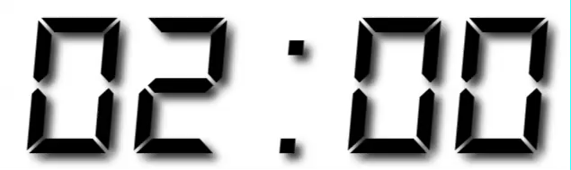
Warm Up
Decide in your group:
Which religions watch the least TV?
Do married people watch more or less TV than single people?

Slide 83
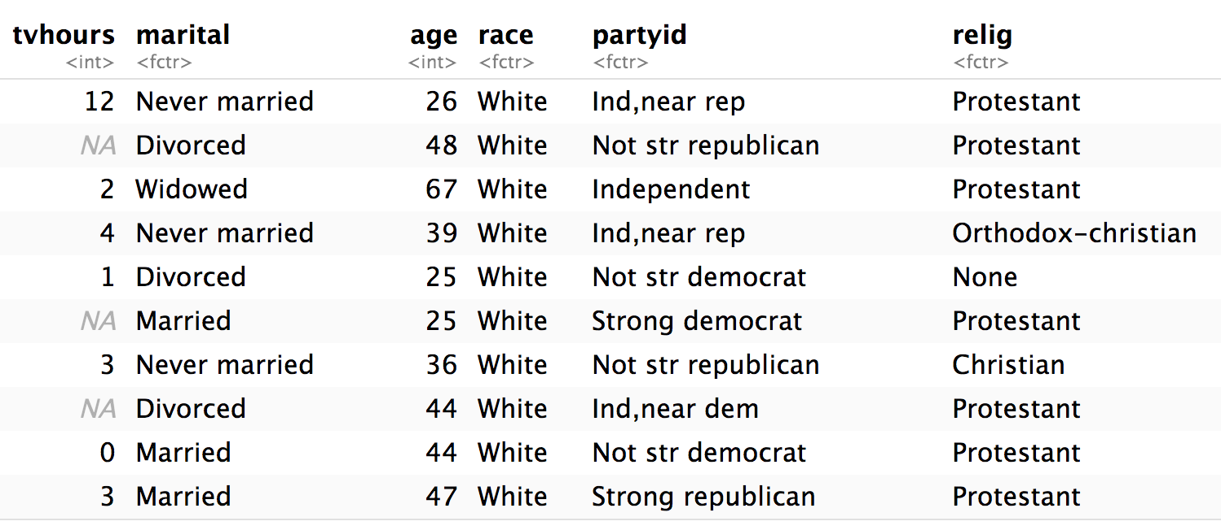
gss_cat
library(forcats)
gss_cat
A sample of data from the General Social Survey, a long-running US survey conducted by NORC at the University of Chicago.

Slide 84
Which religions watch the least TV?
gss_cat %>%
filter(!is.na(tvhours)) %>%
group_by(relig) %>%
summarise(tvhours = mean(tvhours)) %>%
ggplot(aes(tvhours, relig)) +
geom_point()

Slide 85
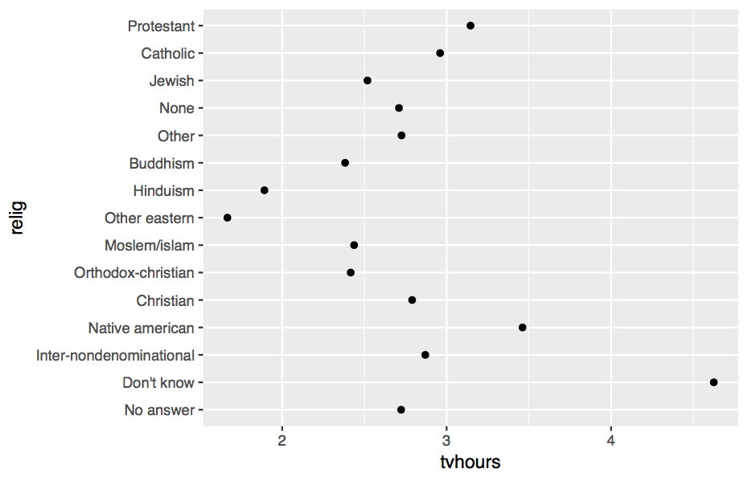

Slide 86
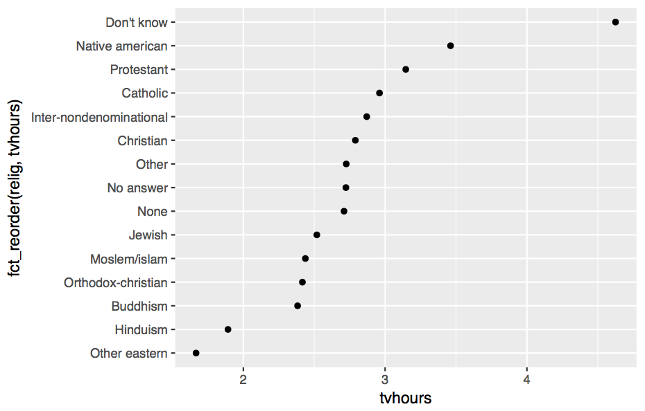

Slide 87
Which do you
prefer?

Slide 88
Why is the Y axis in this order?

Slide 89
Why is the Y axis in this order?
Because the
levels of relig have this order

Slide 90
levels()
Use levels() to access a factor’s levels
levels(gss_cat$relig)
## [1] "No answer" "Don't know"
## [3] "Inter-nondenominational" "Native american"
## [5] "Christian" "Orthodox-christian"
## [7] "Moslem/islam" "Other eastern"
## [9] "Hinduism" "Buddhism"
## [11] "Other" "None"
## [13] "Jewish" "Catholic"
## [15] "Protestant" "Not applicable"

Slide 91
Most useful skills
Reorder the levels
Recode the levels
Collapse levels

Slide 92
Reordering
levels

Slide 93
fct_reorder()
Reorders the levels of a factor based on the result of fun(x) applied to each group of cases (grouped by level).
fct_reorder(f, x, fun = median, …, .desc = FALSE)
factor to reorder
variable to reorder by
(in conjunction with fun)
function to reorder by
(in conjunction with x)
put in descending order?

Slide 94
gss_cat %>%
filter(!is.na(tvhours)) %>%
group_by(relig) %>%
summarise(tvhours = mean(tvhours)) %>%
ggplot(aes(tvhours, fct_reorder(relig, tvhours))) +
geom_point()

Slide 96
Your Turn 3
Repeat the previous demonstration, some of whose code is in your notebook, to make a sensible graph of average TV consumption by marital status.

Slide 97
gss_cat %>%
filter(!is.na(tvhours)) %>%
group_by(marital) %>%
summarise(tvhours = mean(tvhours)) %>%
ggplot(aes(tvhours, fct_reorder(marital, tvhours))) +
geom_point()

Slide 98
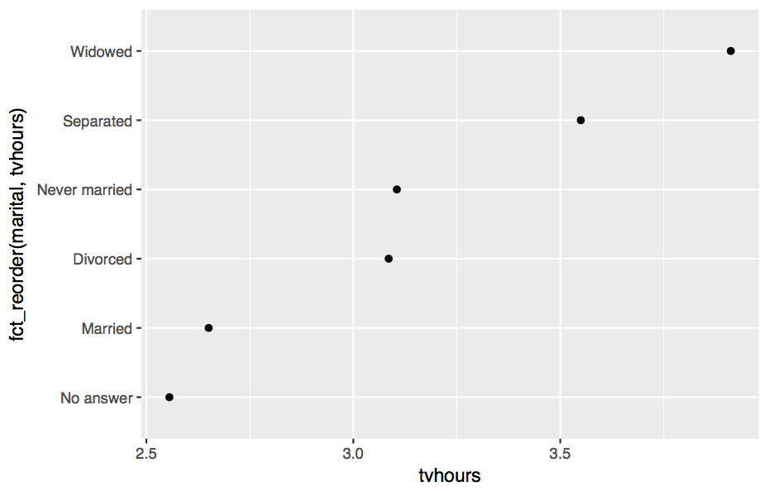

Slide 99
fct_reorder2()
Reorders the levels of a factor by the Y values associated with the largest X values.
fct_reorder2(f, x, y, fun = last2, …, .desc = FALSE)
X variable
Y variable

Slide 100
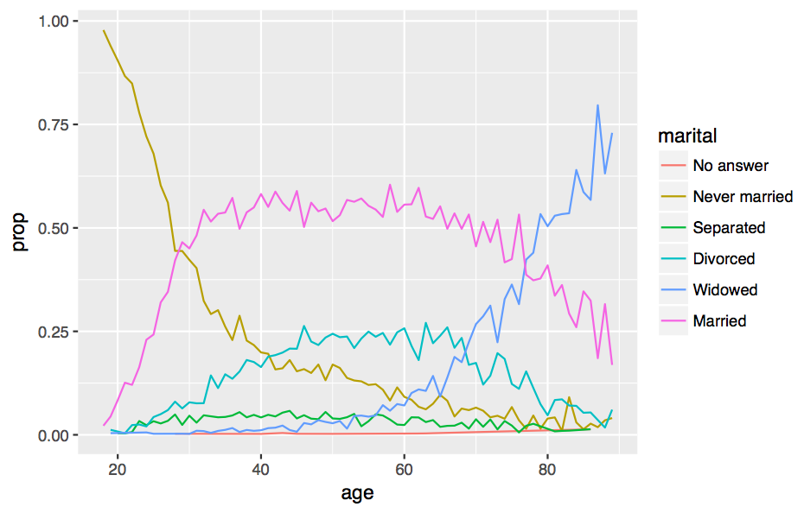
Proportion who report each marital status by age

Slide 101
gss_cat %>%
drop_na(age) %>%
group_by(age, marital) %>%
count() %>%
mutate(prop = n / sum(n)) %>%
ggplot(aes(age, prop, color = marital)) +
geom_line()

Slide 102
gss_cat %>%
drop_na(age) %>%
group_by(age, marital) %>%
count() %>%
mutate(prop = n / sum(n)) %>%
ggplot(aes(age, prop,
color = fct_reorder2(marital, age, prop)) +
geom_line()

Slide 103
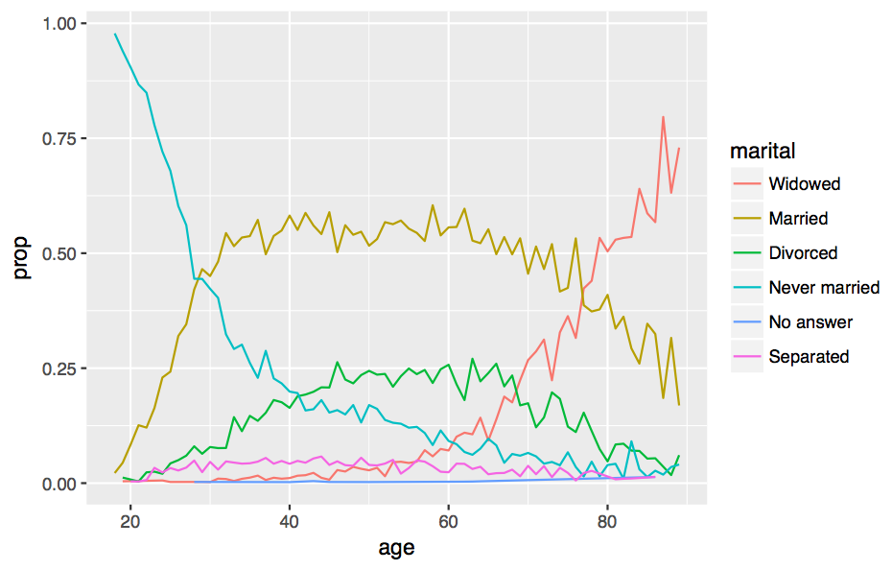

Slide 104
Similar reordering functions

Slide 105
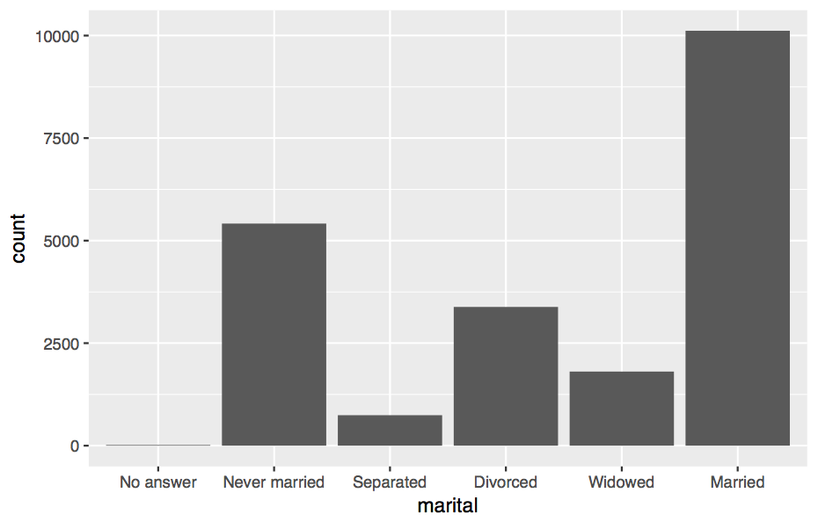
gss_cat %>%
ggplot(aes(marital)) + geom_bar()

Slide 106
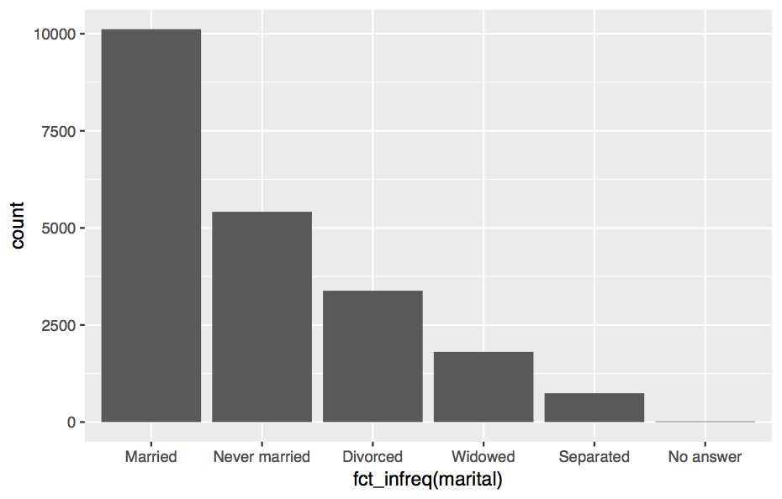
fct_infreq
gss_cat %>%
ggplot(aes(fct_infreq(marital))) + geom_bar()

Slide 107
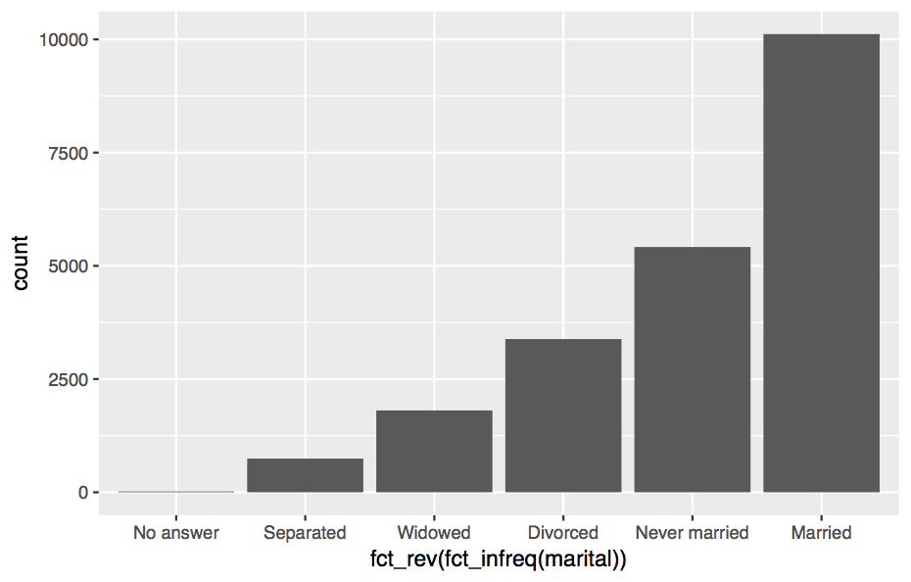
fct_rev
gss_cat %>%
ggplot(aes(fct_rev(fct_infreq(marital)))) + geom_bar()

Slide 108
Changing
level values

Slide 109
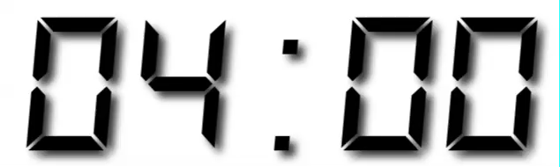
Your Turn 4
Do you think liberals or conservatives watch more TV?
Compute average tv hours by party ID and then plot the results.

Slide 110
gss_cat %>%
filter(!is.na(tvhours)) %>%
group_by(partyid) %>%
summarise(tvhours = mean(tvhours)) %>%
ggplot(aes(tvhours, fct_reorder(partyid, tvhours))) +
geom_point() +
labs(y = "partyid")

Slide 111
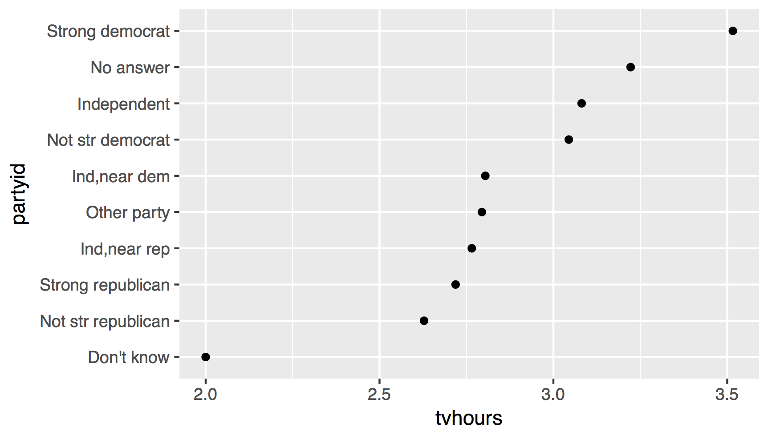
1. How can we improve these labels?

Slide 112
fct_recode()
Changes values of levels
fct_recode(f, Independent = "Ind,near dem")
factor with levels
new level = old level pairs (as a named character vector)

Slide 113
gss_cat %>%
filter(!is.na(tvhours)) %>%
mutate(partyid = fct_recode(partyid,
"Republican, strong" = "Strong republican",
"Republican, weak" = "Not str republican",
"Independent, near rep" = "Ind,near rep",
"Independent, near dem" = "Ind,near dem",
"Democrat, weak" = "Not str democrat",
"Democrat, strong" = "Strong democrat")) %>%
group_by(partyid) %>%
summarise(tvhours = mean(tvhours)) %>%
ggplot(aes(tvhours, fct_reorder(partyid, tvhours))) +
geom_point() + labs(y = "partyid")

Slide 114
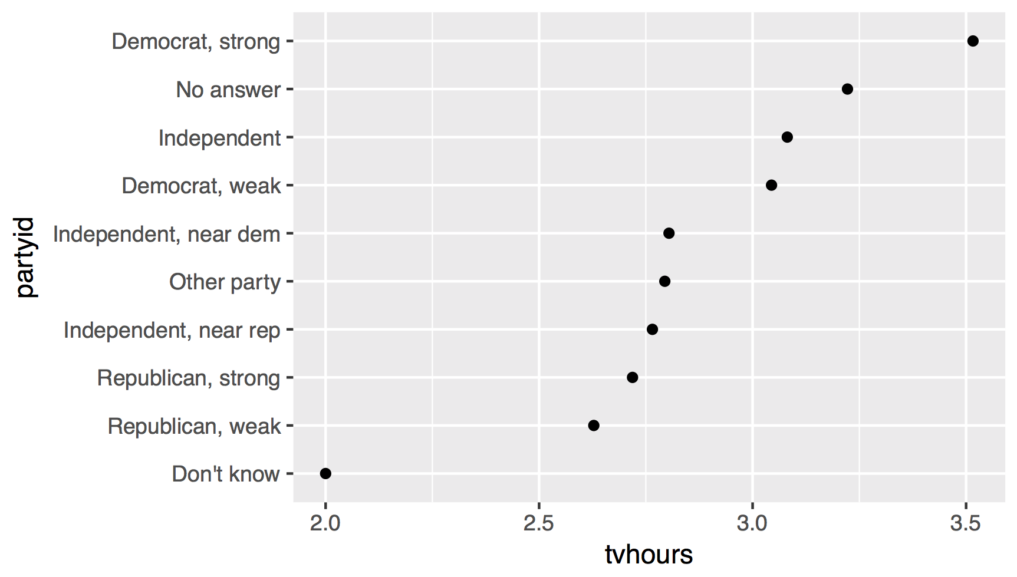
liberal
liberal
liberal
conservative
2. How can we combine these groups?
conservative
conservative

Slide 115
Collapsing
levels

Slide 116
fct_collapse()
Collapses multiple levels into single levels
fct_collapse(f, Liberal = c("Democrat, strong",
"Democrat, weak"))
factor with levels
named arguments set to a character vector (levels in the vector will be collapsed to the name of the argument)

Slide 117
gss_cat %>%
filter(!is.na(tvhours)) %>%
mutate(partyid = fct_collapse(partyid,
conservative = c("Strong republican",
"Not str republican",
"Ind,near rep"),
liberal = c("Strong democrat",
"Not str democrat",
"Ind,near dem"))) %>%
group_by(partyid) %>%
summarise(tvhours = mean(tvhours)) %>%
ggplot(aes(tvhours, fct_reorder(partyid, tvhours))) +
geom_point() + labs(y = "partyid")

Slide 118
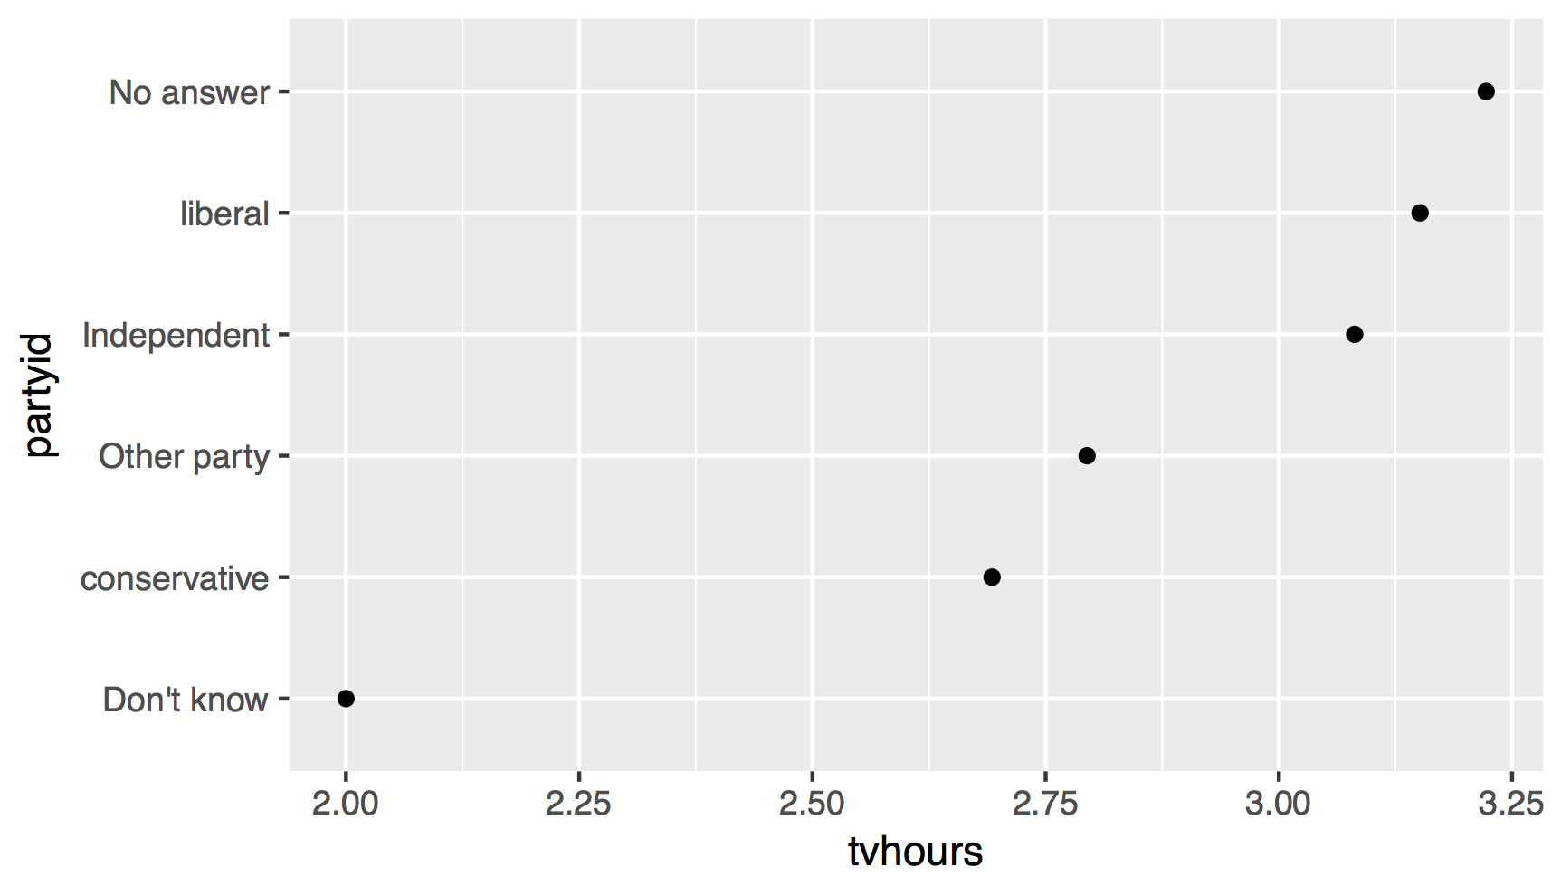
There are relatively few points in each of these groups

Slide 119
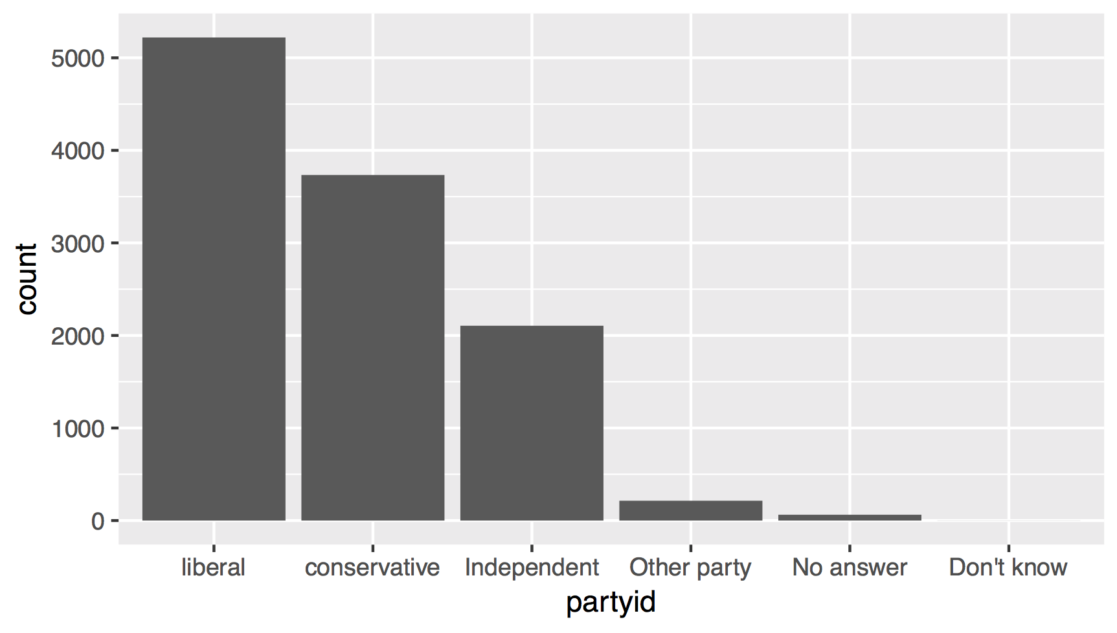

Slide 120
fct_lump()
Collapses levels with fewest values into a single level. Collapses as many levels as possible such that the new level is still the smallest.
fct_lump(f, other_level = "Other", …)
factor with levels
name of new level

Slide 121
gss_cat %>%
filter(!is.na(tvhours)) %>%
mutate(partyid = partyid %>%
fct_collapse(
conservative = c("Strong republican",
"Not str republican", "Ind,near rep"),
liberal = c("Strong democrat", "Not str democrat",
"Ind,near dem")) %>%
fct_lump()
) %>%
group_by(partyid) %>%
summarise(tvhours = mean(tvhours)) %>%
ggplot(aes(tvhours, fct_reorder(partyid, tvhours))) +
geom_point() + labs(y = "partyid")

Slide 122
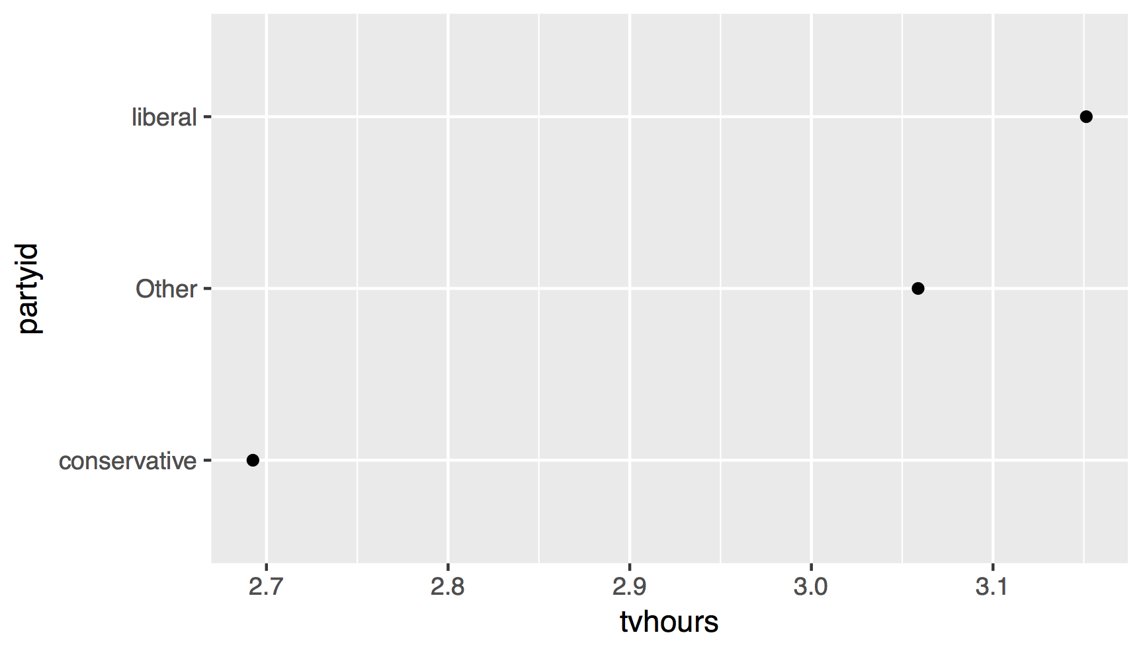

Slide 123
gss_cat %>%
filter(!is.na(tvhours)) %>%
mutate(partyid = partyid %>%
fct_collapse(
conservative = c("Strong republican",
"Not str republican", "Ind,near rep"),
liberal = c("Strong democrat", "Not str democrat",
"Ind,near dem")) %>%
fct_lump()
) %>%
group_by(partyid) %>%
summarise(tvhours = mean(tvhours)) %>%
ggplot(aes(fct_reorder(partyid, tvhours), tvhours)) +
geom_col() + labs(x = "partyid") + coord_flip()

Slide 124
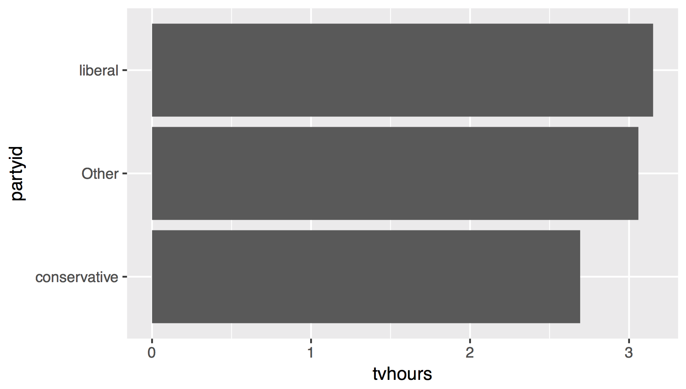

Slide 125
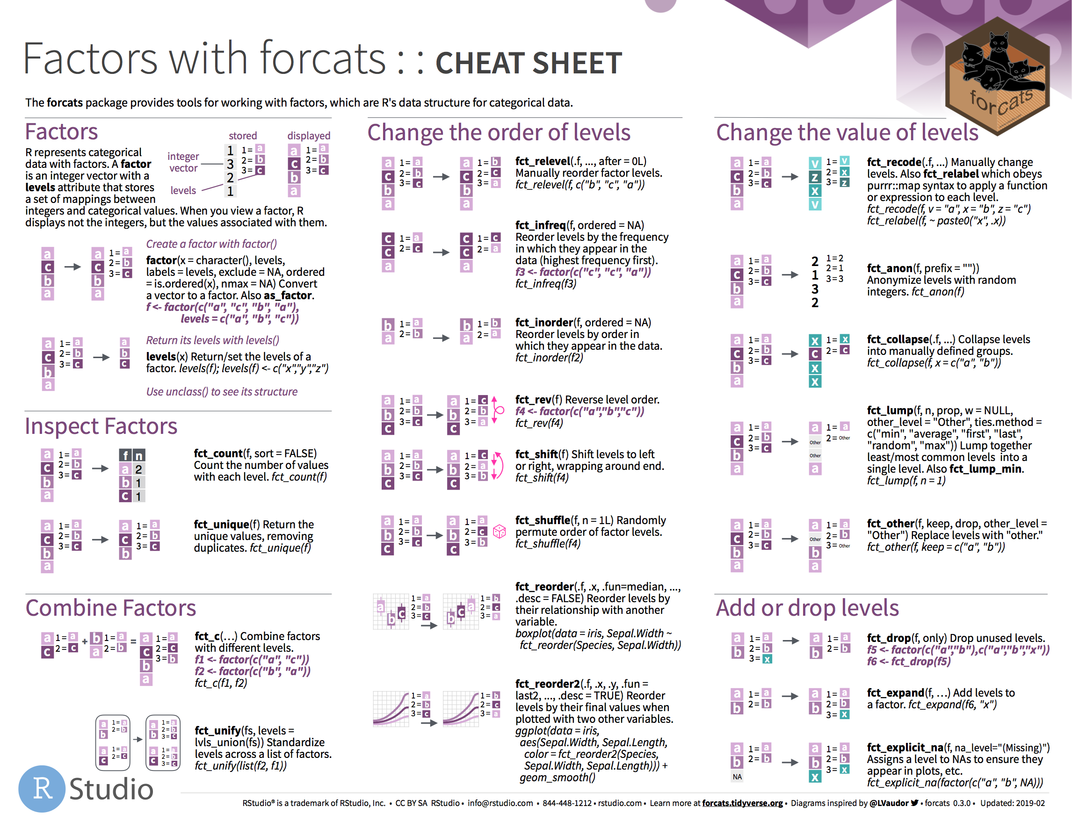
factors

Slide 126
Date times

Slide 127
Quiz
Does every year have 365 days?

Slide 128
Quiz
Does every day have 24 hours?

Slide 129
Quiz
Does every minute have 60 seconds?

Slide 130
Quiz
What does a month measure?

Slide 131
Dates and times involve:
instants - specific moments in time (e.g., Jan 1, 2017)
time spans - spans of time (e.g., a day)

Slide 132
Most useful skills
Creating dates/times (i.e. parsing)
Access and change parts of a date
Deal with time zones
Do math with instants and time spans

Slide 133
Warm Up
Decide in your group:
What is the best time of day to fly?
What is the best day of the week to fly?

Slide 134
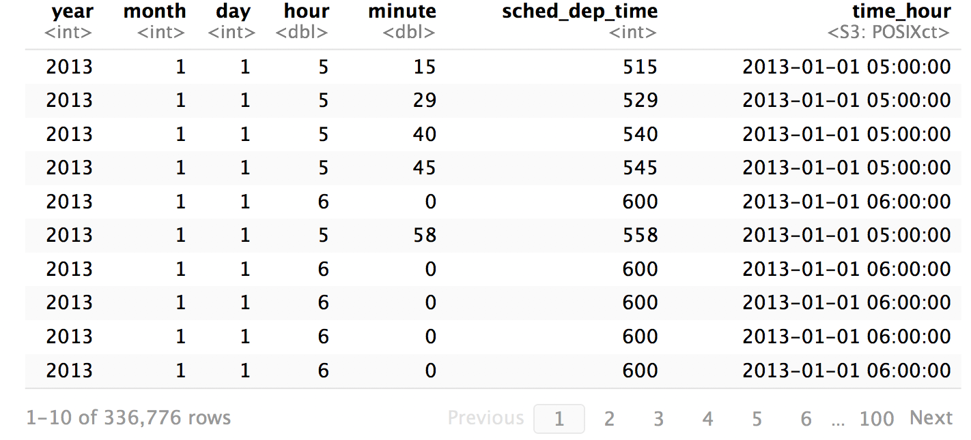
flights %>% select(c(1, 2, 3, 17, 18, 5, 19))

Slide 135
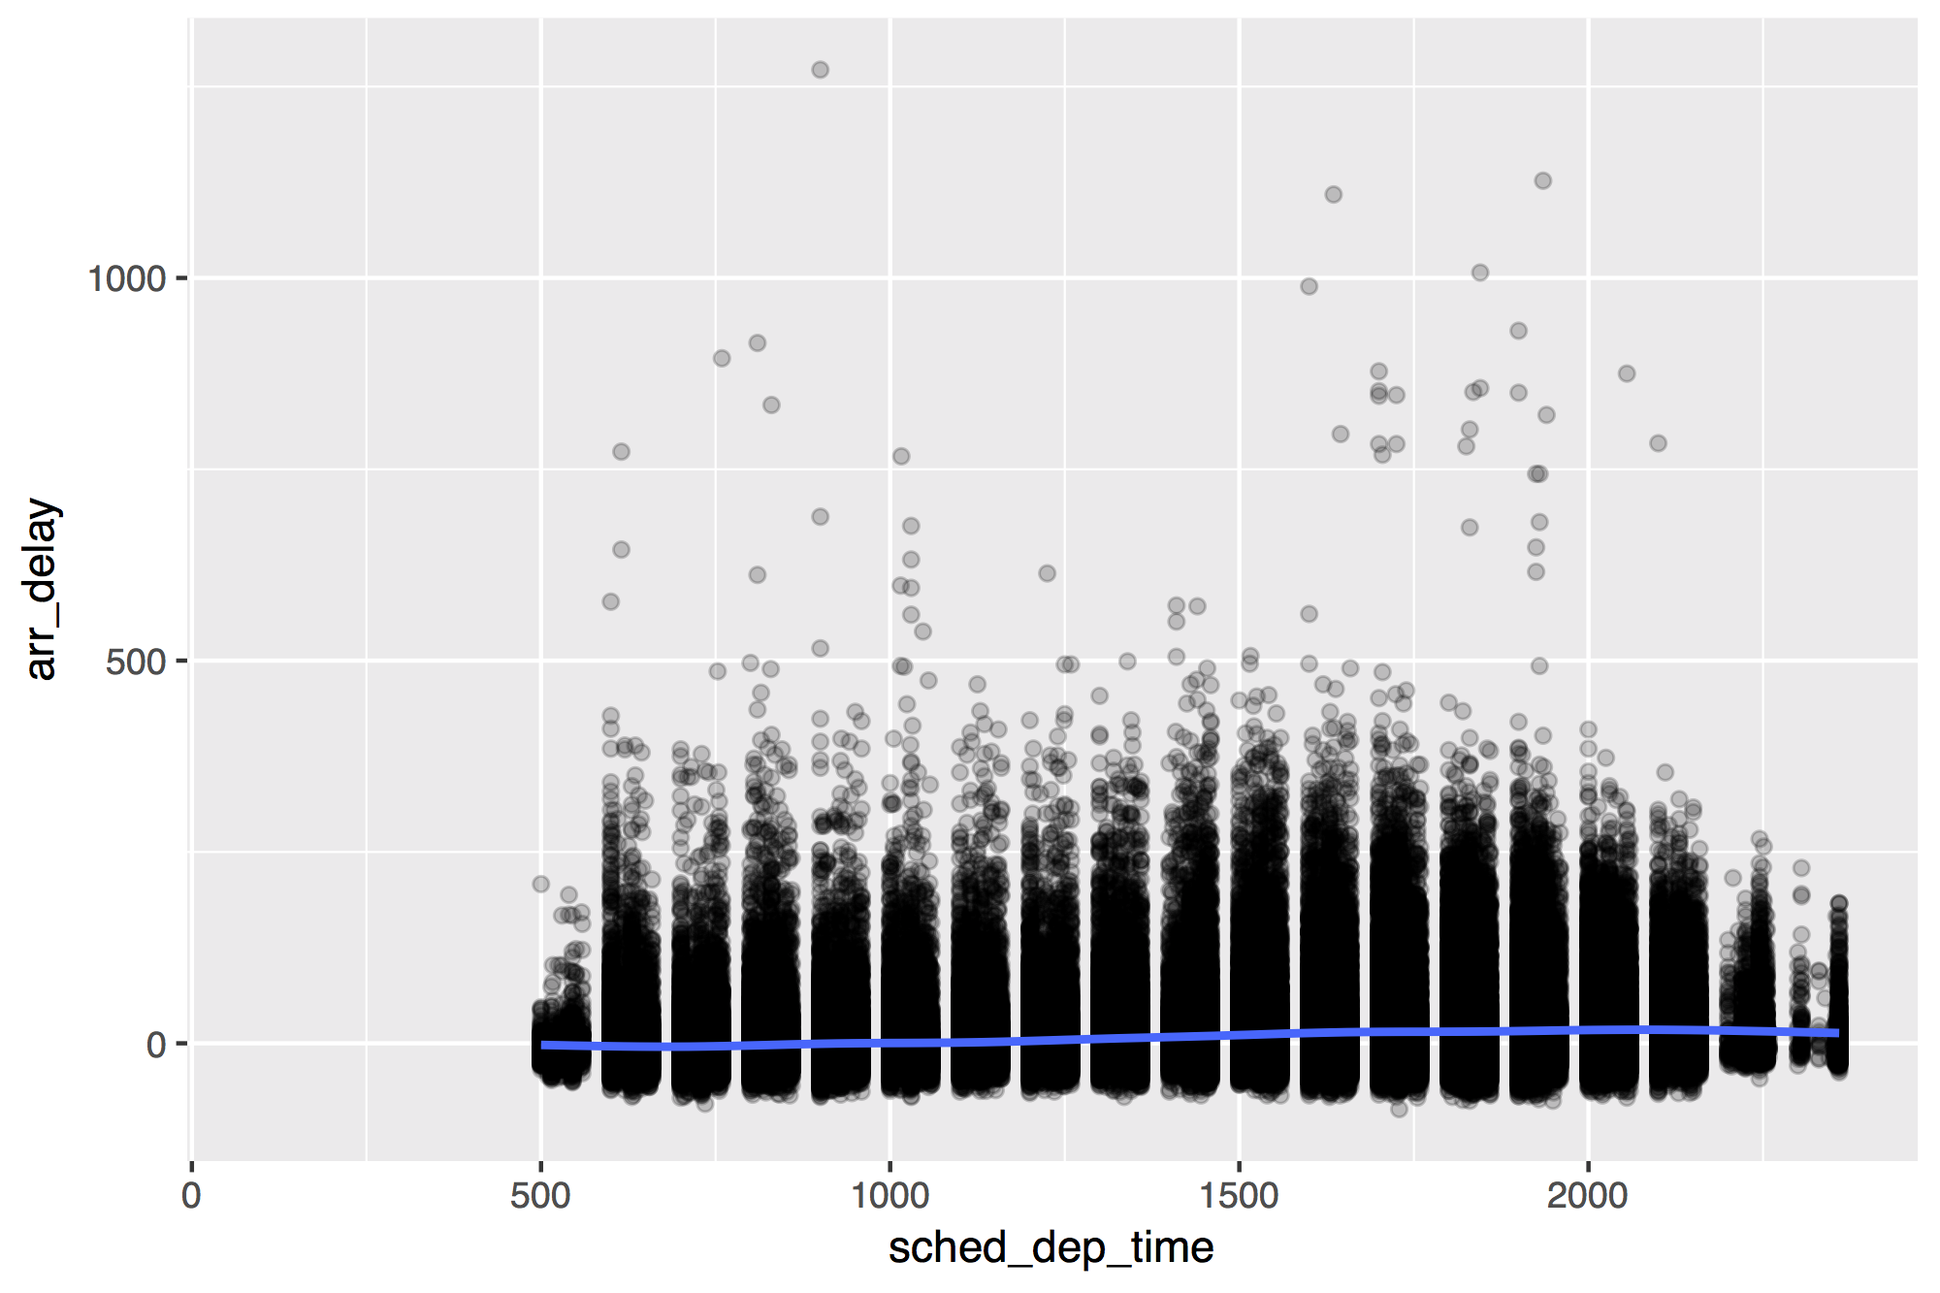
flights %>%
ggplot(mapping = aes(x = sched_dep_time, y = arr_delay)) +
geom_point(alpha = 0.2) + geom_smooth()

Slide 136
flights %>% select(c(1, 2, 3, 17, 18, 5, 19))

Slide 137
Creating dates
and times

Slide 138
(some of) R’s instant classes
2017-01-01 12:34:56

Slide 139
POSIXct
2017-01-01 12:34:56
Stored as the number of seconds since 1970-01-01 00:00:00
Sys.time()
## "2017-01-01 12:34:56 EST"
unclass(Sys.time())
## 1483292096

Slide 140
Dates
2017-01-01 12:34:56
Stored as the number of days since 1970-01-01
Sys.Date()
## "2017-01-01"
unclass(Sys.Date())
## 17167

Slide 141
hms
A class for representing just clock times.
# install.packages("tidyverse")
library(hms)

Slide 142
install.packages("tidyverse")
library("tidyverse")
does the equivalent of
does the equivalent of
install.packages("ggplot2")
install.packages("dplyr")
install.packages("tidyr")
install.packages("readr")
install.packages("purrr")
install.packages("tibble")
install.packages("stringr")
install.packages("forcats")
install.packages("lubridate")
install.packages("hms")
install.packages("DBI")
install.packages("haven")
install.packages("httr")
install.packages("jsonlite")
install.packages("readxl")
install.packages("rvest")
install.packages("xml2")
install.packages("modelr")
install.packages("broom")
library("ggplot2")
library("dplyr")
library("tidyr")
library("readr")
library("purrr")
library("tibble")
library("stringr")
library("forcats")
Notes:
The core tidyverse packages are the ones that you are likely to use in every analysis. You need to load non-core tidyverse packages individually with library()

Slide 143
hms()
2017-01-01 12:34:56
hms(seconds, minutes, hours, days)
numbers of each unit to add to the time
* on a typical day

Slide 144
hms
2017-01-01 12:34:56
Stored as the number of seconds since 00:00:00.*
hms(seconds = 56, min = 34, hour = 12)
## 12:34:56
unclass(hms(56, 34, 12))
## 45296
* on a typical day

Slide 145
Your Turn 5
What is the best time of day to fly?
Use the hour and minute variables in flights to make a new variable that shows the time of each flight as an hms.
Then use a smooth line to plot the relationship between time of day and arr_delay.

Slide 146
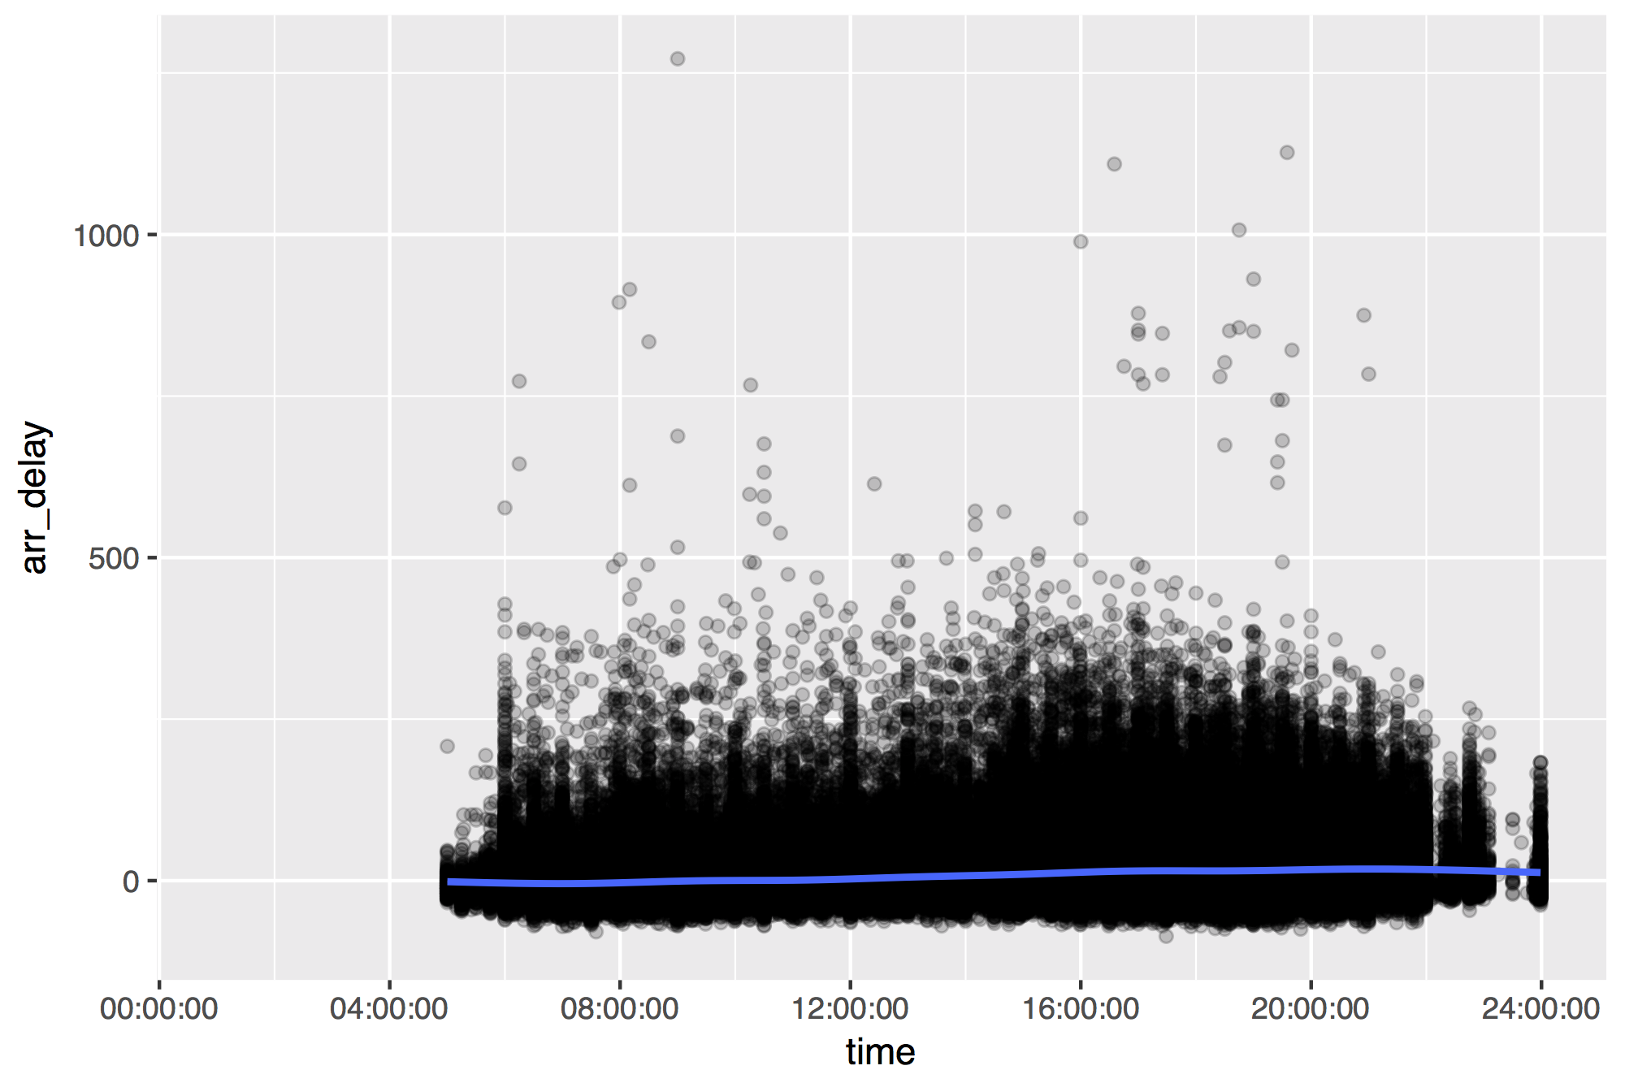
flights %>%
mutate(time = hms(hour = hour, minute = minute)) %>%
ggplot(aes(time, arr_delay)) +
geom_point(alpha = 0.2) + geom_smooth()

Slide 147
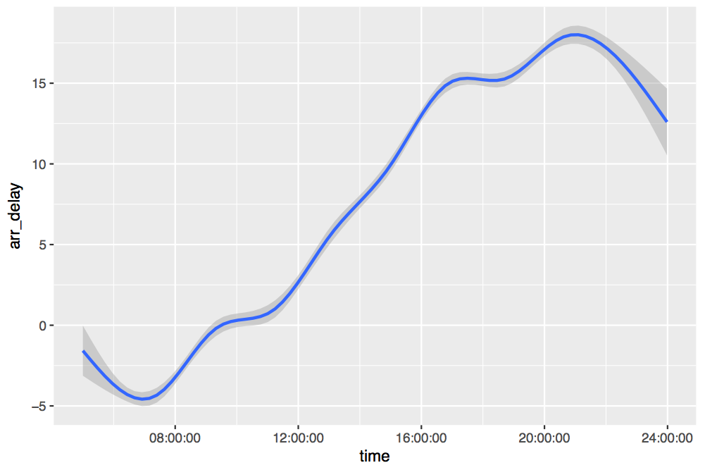

Slide 148
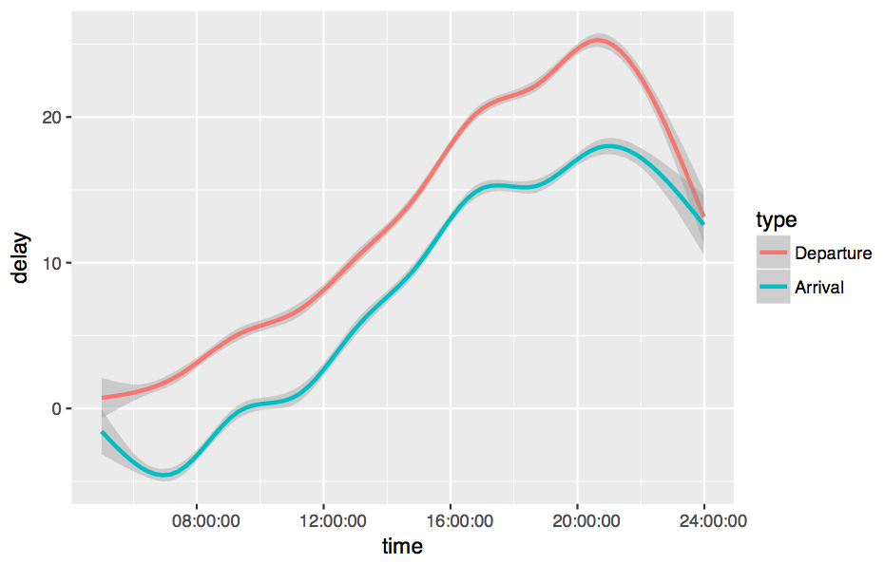

Slide 149
Challenge
Work as a group to modify your code to make the previous graph. You will need to:
Select just the time, arr_delay, and dep_delay variables
Gather the arr_delay and dep_delay columns into a key:value column pair names type and delay
Recode the delay column to contain "Departure" and "Arrival" values
Reorder the type column (which is a factor) by the time and "value" column.

Slide 150
flights %>%
mutate(time = hms::hms(hour = hour, minute = minute)) %>%
select(time, arr_delay, dep_delay) %>%
gather("type", "delay", 2:3) %>%
mutate(type = fct_recode(type,
"Arrival" = "arr_delay", "Departure" = "dep_delay"),
type = fct_reorder2(type, time, delay)) %>%
ggplot(aes(time, delay, color = type)) + geom_smooth()

Slide 151
What is the best day of the week to fly?

Slide 152
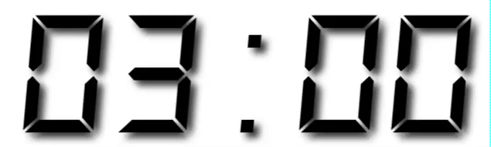
Your Turn 6
Look at the code skeleton for Your Turn 7. Discuss with your neighbor:
What does each line do?
What will the missing parts need to do?

Slide 153
lubridate
Functions for working with dates and time spans
# install.packages("tidyverse")
library(lubridate)

Slide 154
ymd() family
2017-01-01 12:34:56
To parse strings as dates, use the function whose name is y, m, d, h, m, s in the correct order.
ymd("2012/01/11")
mdy("January 11, 2012")
ymd_hms("2012-01-11 01:30:55")

Slide 155
Parsing functions
function | parses to
ymd_hms(), ymd_hm(), ymd_h()
ydm_hms(), ydm_hm(), ydm_h() | POSIXct
dmy_hms(), dmy_hm(), dmy_h()
mdy_hms(), mdy_hm(), mdy_h()
ymd(), ydm(), mdy() | Date (POSIXct if tz specified)
myd(), dmy(), dym(), yq()
hms(), hm(), ms() | Period

Slide 156
ymd() family
To parse strings as dates, use a y, m, d, h, m, s combo
ymd_hms("2017-01-01T12:34:56")
## "2017-01-01 12:34:56 UTC"
ymd_hm("2017/01/01 12:34")
## "2017-01-01 12:34:56 UTC"
dmy("2 January 17")
## "2017-01-02"
ms("34 56")
## "34M 56S"
lubridate functions are separator agnostic

Slide 157
Accessing
and changing components

Slide 158
Accessing components
Extract components by name with a singular name
date <- ymd("2019-01-11")
year(date)
## 2019

Slide 159
Setting components
Use the same function to set components
date
## "2019-01-11"
year(date) <- 1999
date
## "1999-01-11"

Slide 160
Accessing date time components
function | extracts | extra arguments
year() | year
month() | month | label = FALSE, abbr = TRUE
week() | week
day() | day of month
wday() | day of week | label = FALSE, abbr = TRUE
qday() | day of quarter
yday() | day of year
hour() | hour
minute() | minute
second() | second

Slide 161
Accessing components
wday(ymd("2019-01-11"))
## 6
wday(ymd("2019-01-11"), label = TRUE)
## [1] Fri
## 7 Levels: Sun < Mon < Tues < Wed < Thurs < ... < Sat
wday(ymd("2019-01-11"), label = TRUE, abbr = FALSE)
## [1] Friday
## 7 Levels: Sunday < Monday < Tuesday < ... < Saturday

Slide 162
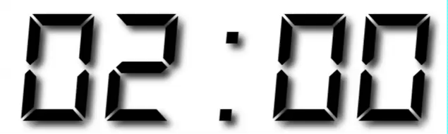
Your Turn 7
Fill in the blank to:
Extract the day of the week of each flight (as a full name) from time_hour.
Plot the average arrival delay by day as a column chart (bar chart).

Slide 163
flights %>%
mutate(weekday = wday(time_hour, label = TRUE, abbr = FALSE)) %>%
group_by(weekday) %>%
filter(!is.na(arr_delay)) %>%
summarise(avg_delay = mean(arr_delay)) %>%
ggplot() +
geom_col(mapping = aes(x = weekday, y = avg_delay))

Slide 164
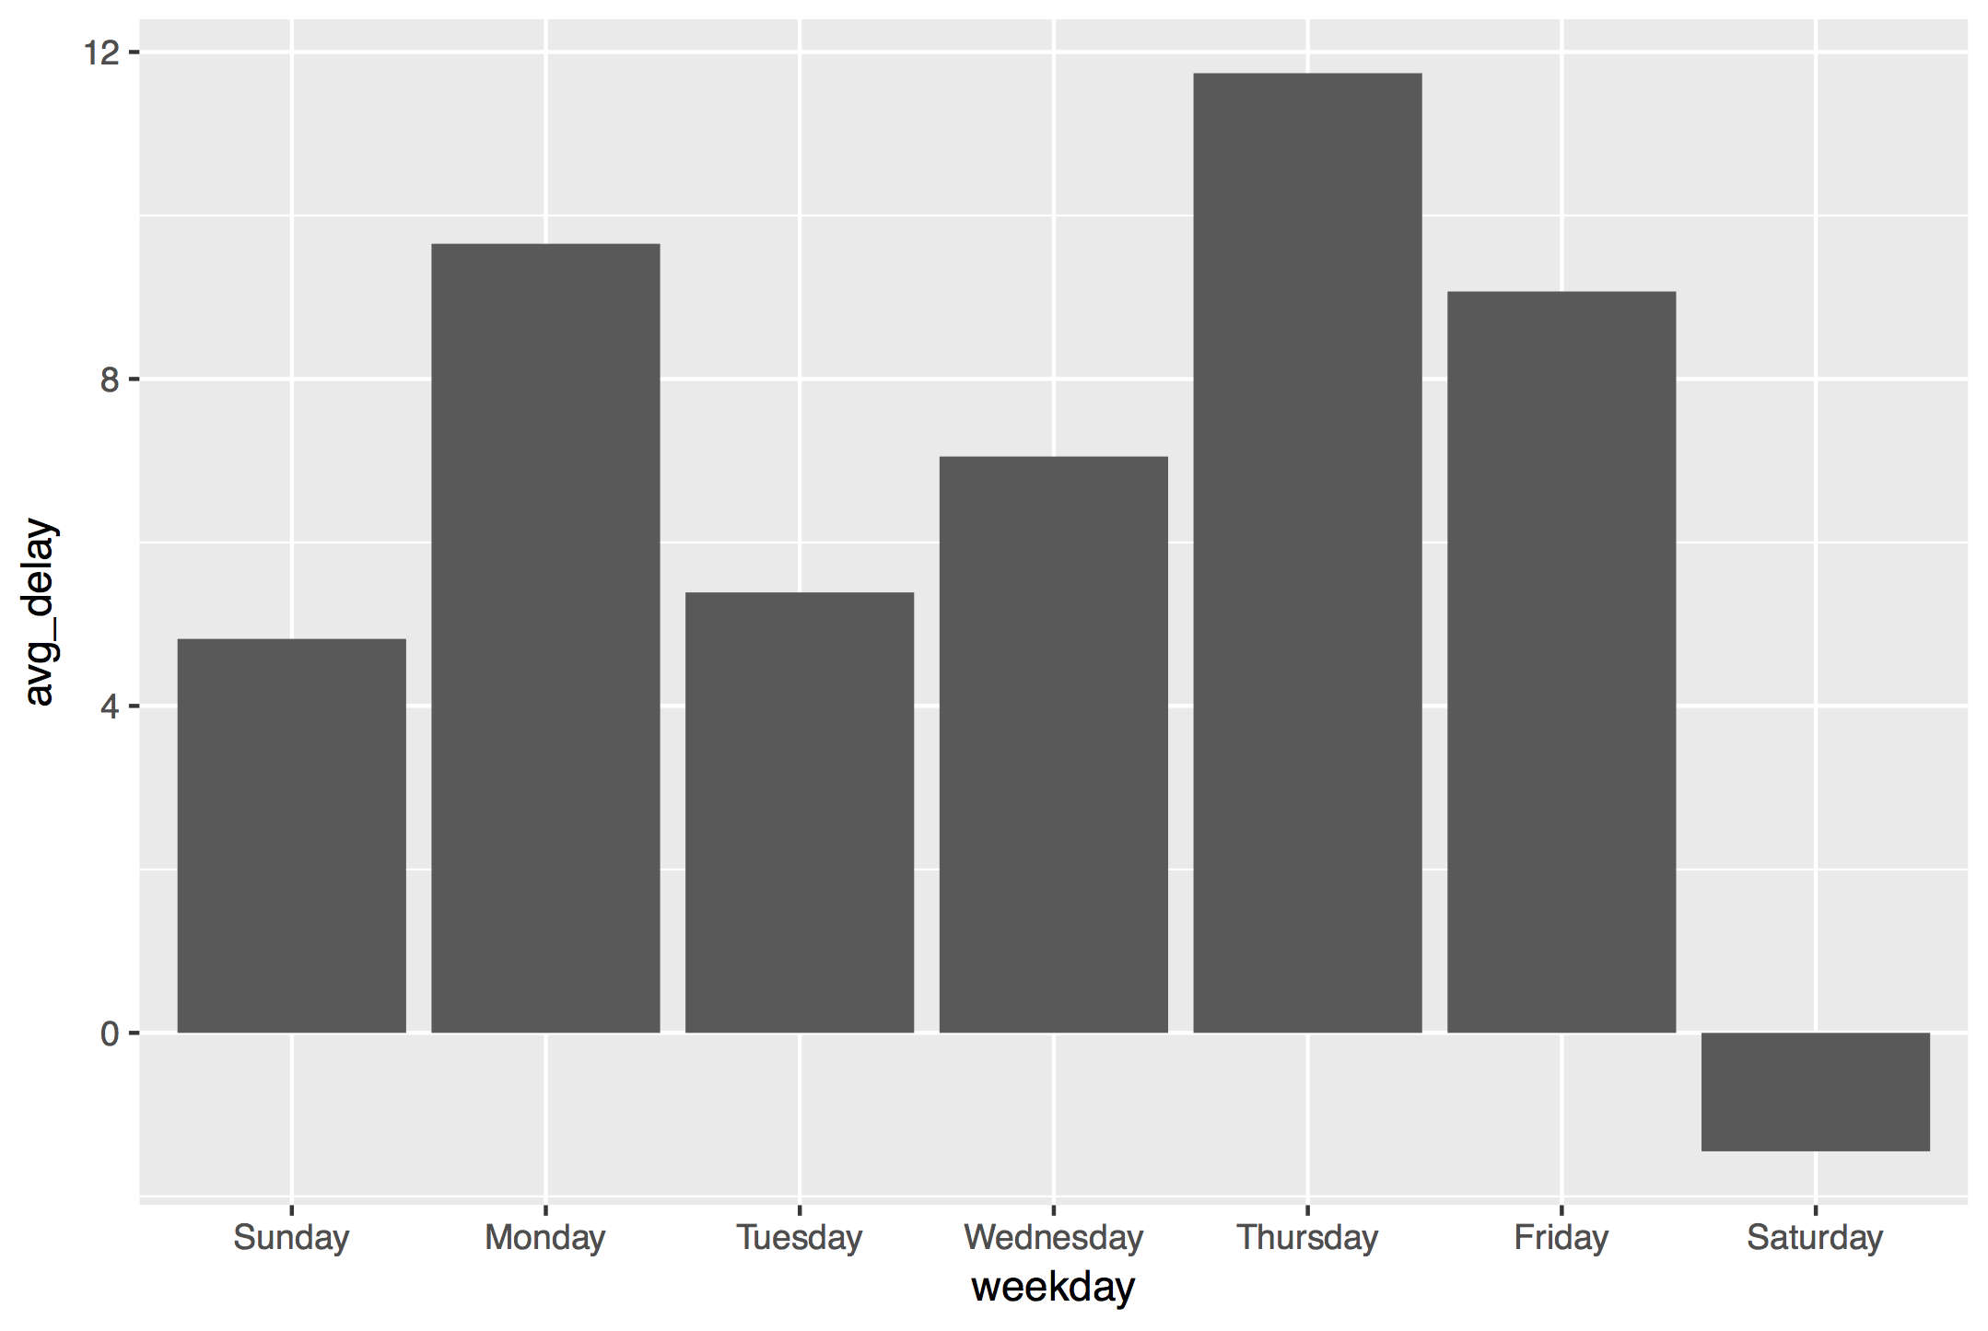

Slide 165
Parsing functions
function | parses to
ymd_hms(), ymd_hm(), ymd_h()
ydm_hms(), ydm_hm(), ydm_h() | POSIXct
dmy_hms(), dmy_hm(), dmy_h()
mdy_hms(), mdy_hm(), mdy_h()
ymd(), ydm(), mdy() | Date (POSIXct if tz specified)
myd(), dmy(), dym(), yq()
hms(), hm(), ms() | Period

Slide 166
Parsing functions
function | parses to
ymd_hms(), ymd_hm(), ymd_h()
ydm_hms(), ydm_hm(), ydm_h() | POSIXct
dmy_hms(), dmy_hm(), dmy_h()
mdy_hms(), mdy_hm(), mdy_h()
ymd(), ydm(), mdy() | Date (POSIXct if tz specified)
myd(), dmy(), dym(), yq()
hms(), hm(), ms() | Period
Same name as
hms() in hms

Slide 167
hms::hms()
package name
function name
* on a typical day

Slide 168
hms::hms()
lubridate::hms()
* on a typical day

Slide 169
hms()
hms::hms(seconds = 3, hours = 5)
Use the
hms() function in the hms package
* on a typical day

Slide 170
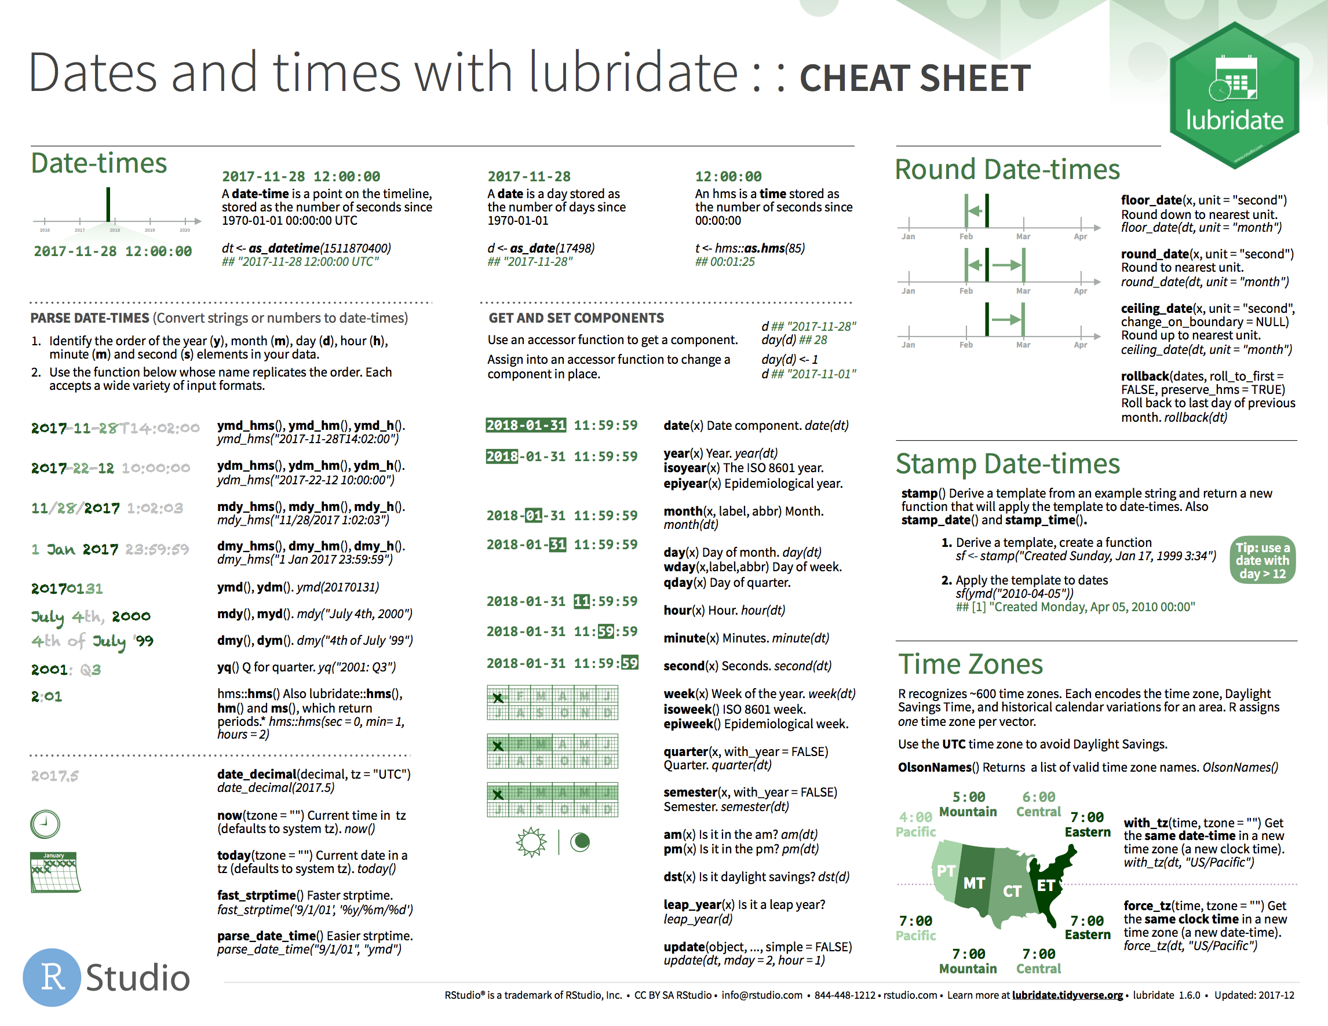
Dates and Times
* on a typical day

Slide 171
Data types with

Slide 172
Dealing with time zones

Slide 173
Quiz
How many time zones are there?

Slide 174
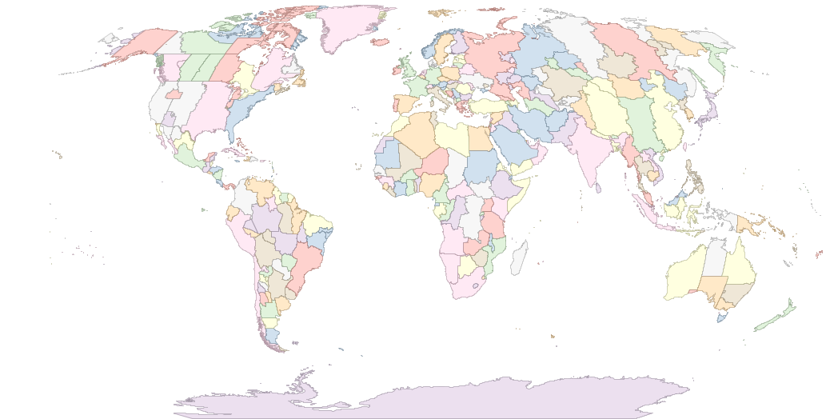
589

Slide 175
Time zone names
OlsonNames()
## "Africa/Abidjan"
## "Africa/Accra"
## "Africa/Addis_Ababa"
## "Africa/Algiers"
## "Africa/Asmara"
## …
## 589 total

Slide 176
Quiz
What is the "benchmark" time zone?

Slide 177
Quiz
What is the "benchmark" time zone?
GMT?
UTC

Slide 178
ymd() family
Lubridate functions use UTC by default
ymd_hms(…, tz = "UTC")

Slide 179
Quiz
nyc <- now(tz = "America/New_York")
la <- now(tz = "America/Los_Angeles")
coasts <- c(nyc, la)
What is the time zone of coasts?

Slide 180
!
R stores time zones as an attribute, which means that:
every datetime in a vector must share the same time zone
time zones are frequently dropped

Slide 181
Quiz
What time should this return? Decide in your group.
nyc <- ymd_hms("2017-01-01 00:00:00",
tz = "America/New_York")
tz(nyc) <- "America/Los_Angeles"

Slide 182
with_tz()
Creates same instant with the new display
with_tz(t,
tz = "America/Denver")
## "2017-01-05 02:00:00 MST"
with_tz(t,
tz = "America/Denver")
## "2017-01-05 02:00:00 MST"
with_tz(t,
tz = "America/Chicago")
## "2017-01-05 03:00:00 CST"
with_tz(t,
tz = "America/Chicago")
## "2017-01-05 03:00:00 CST"
t <- now(
tz = "America/Los_Angeles")
## "2017-01-05 01:00:00 PST"
t <- now(
tz = "America/Los_Angeles")
## "2017-01-05 01:00:00 PST"
with_tz(t,
tz = "America/New_York")
## "2017-01-05 04:00:00 EST"
with_tz(t,
tz = "America/New_York")
## "2017-01-05 04:00:00 EST"

Slide 183
force_tz()
Creates different instants with the same display
force_tz(t,
tz = "America/Denver")
## "2017-01-05 01:00:00 MST"
force_tz(t,
tz = "America/Chicago")
## "2017-01-05 01:00:00 CST"
force_tz(t,
tz = "America/Denver")
## "2017-01-05 01:00:00 MST"
force_tz(t,
tz = "America/Chicago")
## "2017-01-05 01:00:00 CST"
t <- now(
tz = "America/Los_Angeles")
## "2017-01-05 01:00:00 PST"
t <- now(
tz = "America/Los_Angeles")
## "2017-01-05 01:00:00 PST"
force_tz(t,
tz = "America/New_York")
## "2017-01-05 01:00:00 EST"
force_tz(t,
tz = "America/New_York")
## "2017-01-05 01:00:00 EST"

Slide 184
Your Turn
this_instant <- now()
What time is it in Honolulu (Pacific/Honolulu) this instant?
What will it be here when Honolulu clocks show our time?
The time_hour column of flights is saved as UTC. Convert it to the correct time zone for New York City. Notice that the hours element of time_hour already matches flights$hour, which is ostensibly the correct hour in the America/New_York time zone.

Slide 185
this_instant %>%
with_tz("Pacific/Honolulu")
this_instant %>%
force_tz("Pacific/Honolulu") %>%
with_tz("America/New_York")
flights %>%
mutate(time_hour = with_tz(time_hour, "America/New_York")) %>%
select(time_hour)

Slide 186
Doing math with dates and times

Slide 187
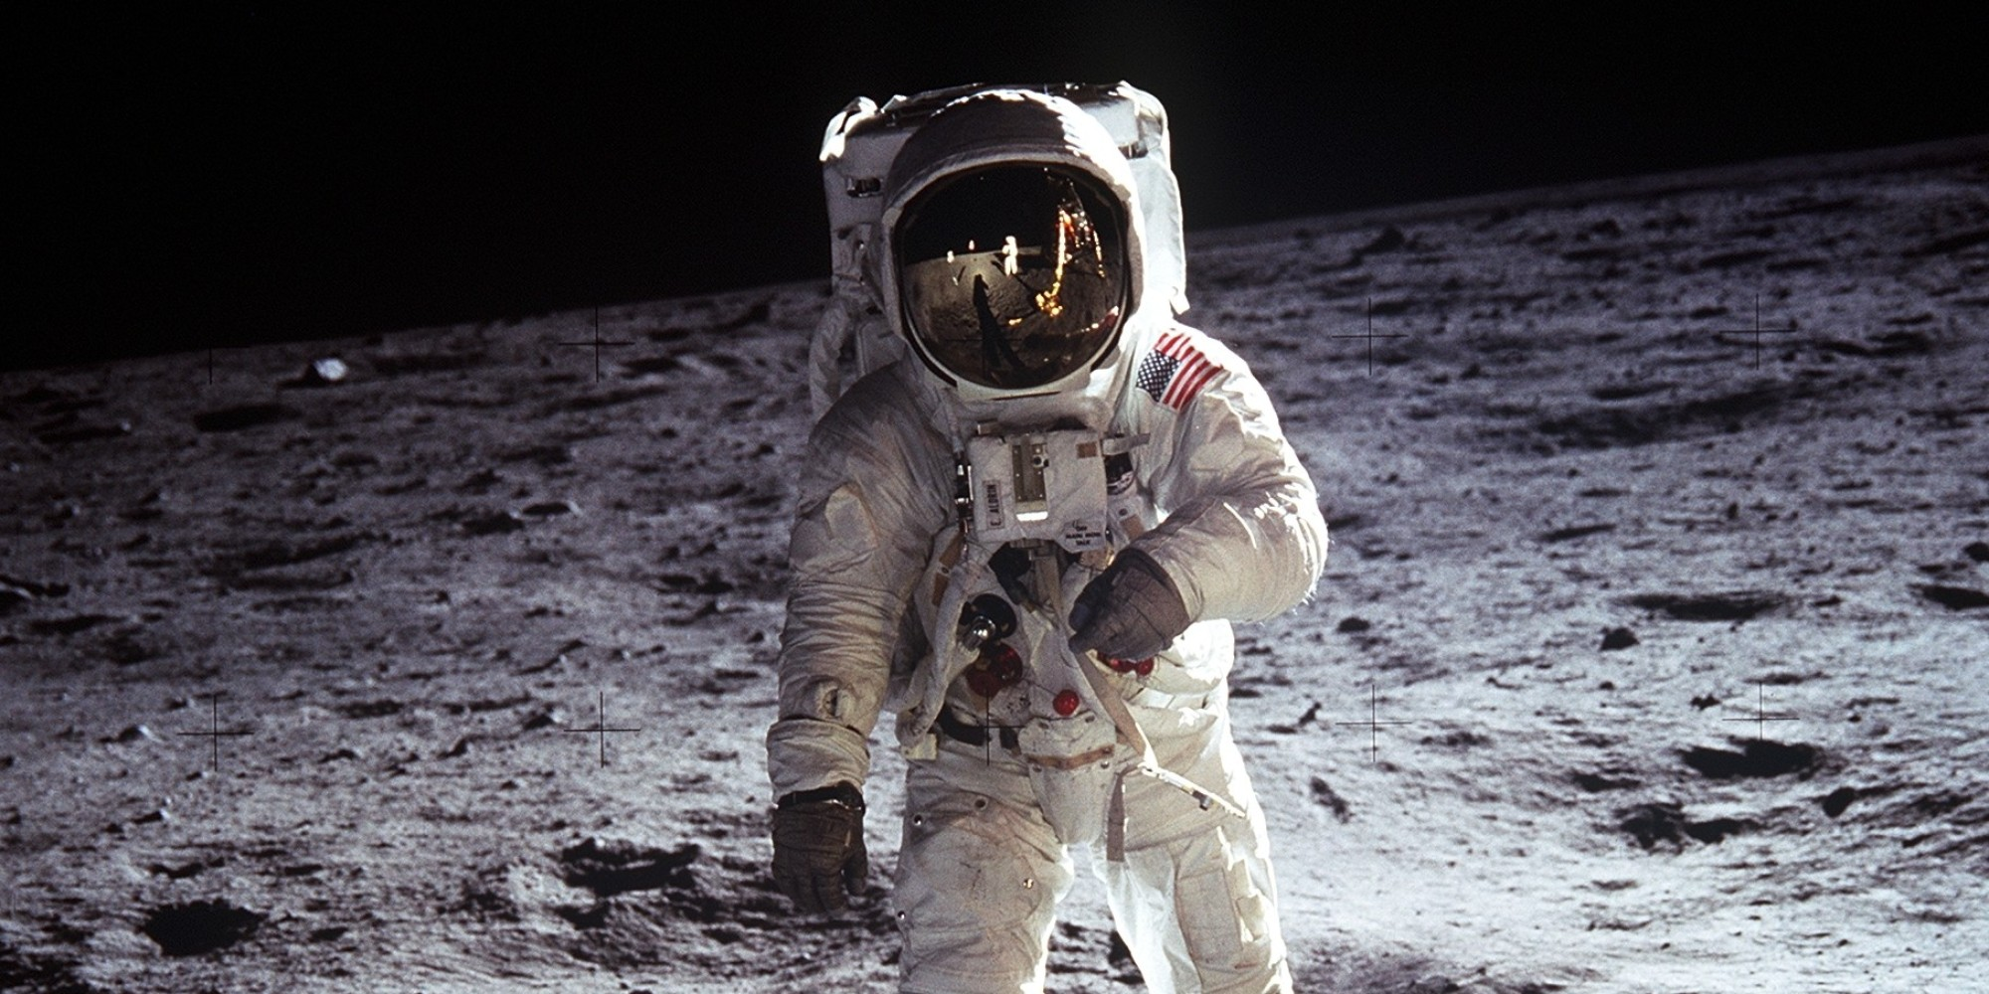
July, 20 1969

Slide 188

Nov, 25 1992

Slide 189
difftimes
When you subtract two dates in R you get a difftime
now() - as.POSIXct(today())
## Time difference of 22.29285 hours
But difftimes use inconsistent units (sometimes weeks, days, hours, minutes, or seconds…)

Slide 190
durations
A time span that is always measured in seconds
as.duration(today() - aladdin)
## "761011200s (~24.11 years)"
as.duration(aladdin - moon_landing)
## "736905600s (~23.35 years)"
Plus, a better display

Slide 191
Math with dates
To do math with dates add and subtract periods
weeks(1) - days(3) + hours(2)
## "4d 2H 0M 0S"
date + months(0:11)
## "2017-01-01" "2017-02-01" "2017-03-01"
## "2017-04-01" "2017-05-01" "2017-06-01"
## "2017-07-01" "2017-08-01" "2017-09-01"
## "2017-10-01" "2017-11-01" "2017-12-01"

Slide 192
Period constructors
function | makes
years(x) | x years
months(x) | x months
weeks(x) | x weeks
days(x) | x days
hours(x) | x hours
minutes(x) | x minutes
seconds(x) | x seconds
milliseconds(x) | x milliseconds
microseconds(x) | x microseconds
nanoseconds(x) | x nanoseconds
picoseconds(x) | x picoseconds

Slide 193
Quiz
What might worry us here?
march_11 + days(1)
## "2016-03-12 08:00:00 EST"
march_12 + days(1)
## "2016-03-13 08:00:00 EDT"

Slide 194
periods
A time span that is measured in clock units
march_11 + days(1)
## "2016-03-12 08:00:00 EST"
march_12 + days(1)
## "2016-03-13 08:00:00 EDT"

Slide 195
durations
If absolute time matters, use seconds or a duration
march_11 + ddays(1)
## "2016-03-12 08:00:00 EST"
march_12 + ddays(1)
## "2016-03-13 09:00:00 EDT"

Slide 196
Duration constructors
function | makes
dyears(x) | x years
dweeks(x) | x weeks
ddays(x) | x days
dhours(x) | x hours
dminutes(x) | x minutes
dseconds(x) | x seconds
dmilliseconds(x) | x milliseconds
dmicroseconds(x) | x microseconds
dnanoseconds(x) | x nanoseconds
dpicoseconds(x) | x picoseconds

Slide 197
Quiz
What should this return? Decide in your group.
months(1) / days(1)

Slide 198
Math with periods
months(1) / days(1)
## estimate only: convert to intervals for accuracy
## 30.4375

Slide 199
Quiz
Can we calculate something like this accurately?
"The month between Jan 1, 2017 and Feb 1, 2017" /days(1)

Slide 200
intervals
A time span that is measured by start and end dates
interval(mdy("Jan 1, 2017"), mdy("Feb 1, 2017"))
## 2017-01-01 UTC--2017-02-01 UTC
mdy("Jan 1, 2017") %--% mdy("Feb 1, 2017")
## 2017-01-01 UTC--2017-02-01 UTC

Slide 201
Divide by periods and durations to compute the length
month1 <- mdy("Jan 1, 2017") %--% mdy("Feb 1, 2017")
month1 / days(1)
## 31

Slide 202
Working with intervals
function | makes
int_start() | access or change the start date
int_end() | access or change the end date
int_diff() | intervals between dates in a vector
int_length() | number of seconds in the interval
int_flip() | switches start and end dates of th interval
int_shift() | shifts an interval by a time span
int_standardize() | flips interval is length is negative
int_aligns(x) | tests whether interval begin or end on same instant
int_overlaps() | tests whether intervals overlap
intersect(), union(), setdiff() | set operations for intervals
%within% | tests whether instants fall within an interval

Slide 203
%within%
Tests whether instants fall within an interval
firsts <- ymd("2017-01-01") + months(0:11)
summer <- ymd("2017-06-21") %--% ymd("2017-09-21")
firsts %within% summer
## FALSE FALSE FALSE FALSE FALSE FALSE
## TRUE TRUE TRUE FALSE FALSE FALSE

Slide 204
Your Turn
Are flight delays worse over the holidays?
NYC Public Schools held winter recess from December 23, 2013 to January 1, 2014. Create an interval that captures the recess.
Complete the code below to plot delays over time during recess vs. the rest of the year
flights %>%
mutate(during_recess = _____________________________,
time = hms::hms(hour = hour, minute = minute)) %>%
ggplot(aes(time, dep_delay, color = during_recess)) +
geom_smooth()

Slide 205
recess <- ymd("2013-12-23") %--% ymd("2014-01-01")
flights %>%
mutate(during_recess = time_hour %within% recess,
time = hms::hms(hour = hour, minute = minute)) %>%
ggplot(aes(time, dep_delay, color = during_recess)) +
geom_smooth()

Slide 206
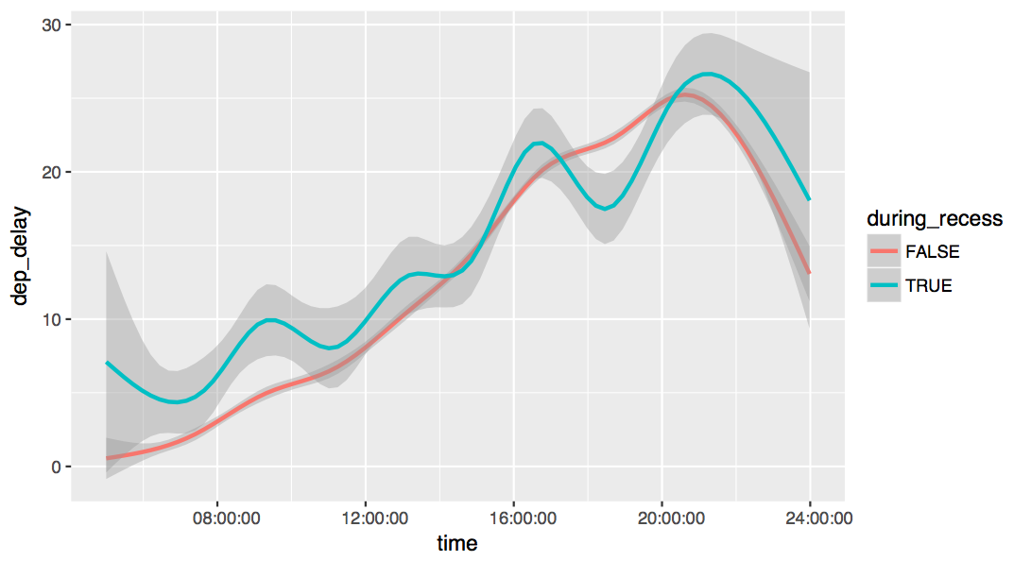

Slide 207
Math with instants
Instant
Time span
Instant
Instant
Time span
?

